Slide 1
Sports Medicine research
Crash Course

Slide 2
Who am I?
Hello! I’m Katy
I have a masters in library and information science
I’m a reference librarian, data analyst, tech caregiver, citation magic worker, and copyright consultant
I can do a lot of stuff to help you

Slide 3
The Librarian
Things I can Do for You
Things that I believe in
Streamlining database research
Emailing documents to you for your convenience
Double checking citations
Gathering information confidentially for you if you’re not able to safely look up materials or bring them home
Helping to develop self confidence in research
Integrating technology into the library
The freedom of intellect and information

Slide 4
I’m not from your major, so how am I able to help you?
Authors of academic papers like to sound smart
Sometimes they put every smart word they know in their titles
I understand the language of research
I only need to be able to rapidly teach myself keywords and key principles by going through the search results
I pass onto students likely candidates that the students then need to review for usefulness

Slide 5
Stepping Up The Scholarly Work
Non-Scholarly Sources
Peer-Reviewed Articles
Wikipedia
Many, but not all, websites
Even .edu sites aren’t guaranteed
Magazines and newspapers (outside of historical context)
Go before a board
Are usually double blind
Called empirical research
Scholarly peer reviewed articles
Found in databases

Slide 6
The World of databases
What Databases Are
What Databases Are Not
Databases are a collection of snippets of data that make more sense in context.
They grow and evolve overtime
They require decent construction and searching skills
Basic search engine
Intuitive
Static
Indiscriminate

Slide 7
How To Approach the Databases
Do not start with a database
Start with Wikipedia
Read the article about the general nature of your topic
Write down a list of some keywords you find.
Use these keywords when you search in the database
Still can’t find anything? Call a librarian.

Slide 8
Why Can’t I Just Google Things?
Copyright laws
Limited access to journals
Google does not index many scholarly journals
Google scholar will ask for payment for results or full text
If you can’t find databases sources (which sometimes happens) come to the library for help navigating Google Scholar

Slide 9
This Is A Lot of Extra Work…
Why in the world am I asking you to do some extra work?
Assignments will only get to be more complex, and learning the basics can only help
The time investment that you spend upfront will mean less time searching for sources

Slide 10
Databases!
pubMed
Sportdiscuss
Nurses/academic edition
MedLine

Slide 11
Creds everywhere
This card has the credentials for the library databases
Anytime an article requires a login to access, you just use these credentials
Please take a card for your own records
I highly recommend taking a picture in case you find yourself using a different computer
Because of copyright law, I can’t put these credentials online.

Slide 12
Test Run for sportdiscus

Slide 13
Now what?
Narrow your search
Dates
Type
Level of hoity-toity importantness

Slide 14
Looks can be deceiving

Slide 15
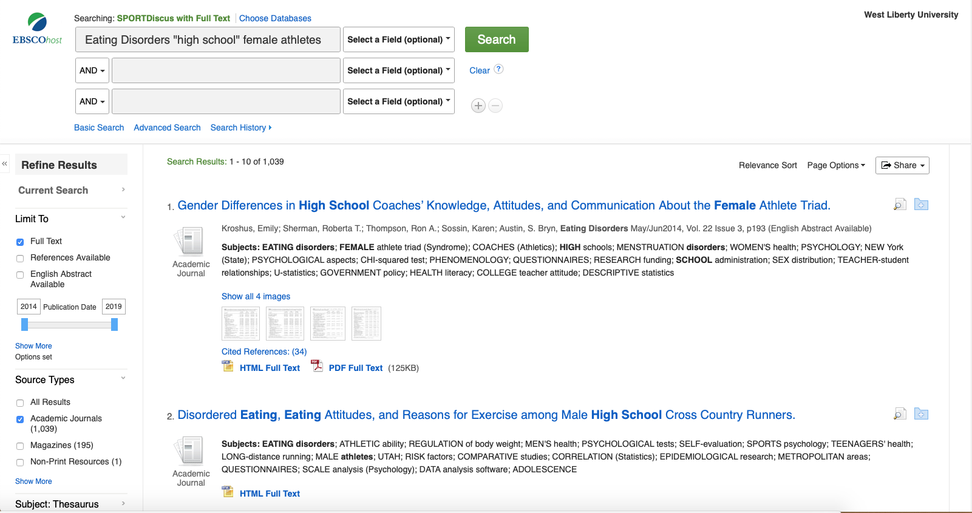
Sometimes a search doesn’t go as planned…

Slide 16
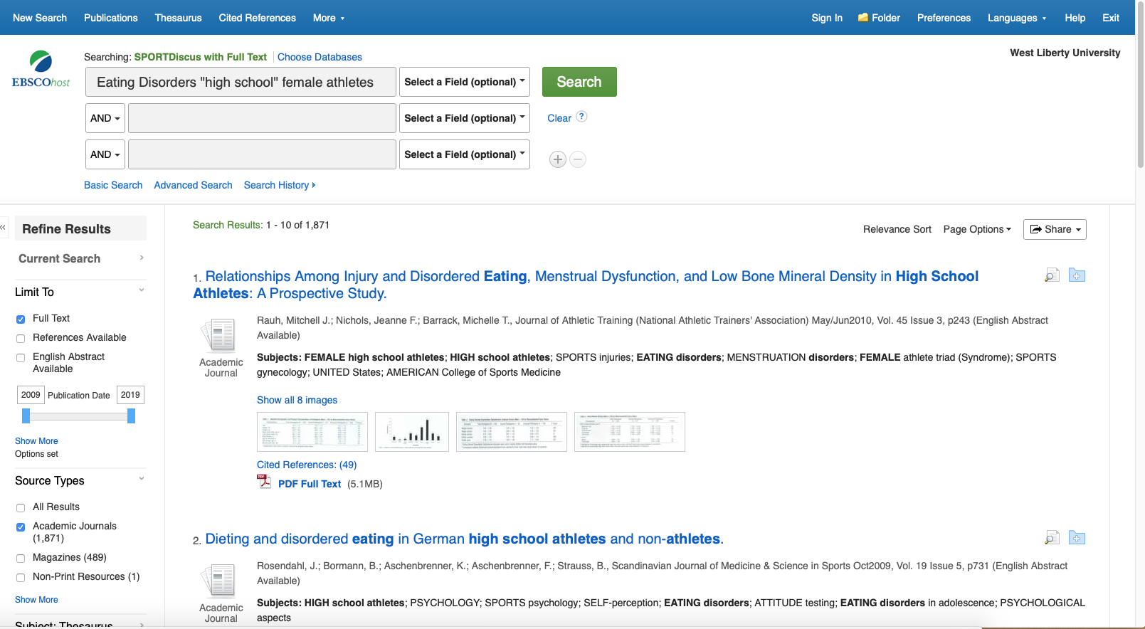
Sometimes you have to tweak your settings

Slide 17
Behold the side bar awesomeness
Search for Full text almost always!
Select scholarly (peer reviewed) journals
Choose a publication date span (best to choose previous five years)
Select academic journals

Slide 18
Weed out the weird
Using the sidebar allows you to ensure that the information you’re getting is reliable and up to date.

Slide 19
Always download the article!
Build your own research library
Some software that can help:
Microsoft One Drive
Google drive
Icloud drive
Dropbox
Box
And many others

Slide 20
What if you came to the library for help, and the articles ended up not being useful?
It happens!
Research is a cycle
We will find new articles
It won’t hurt my feelings if those articles didn’t work out
Come back as often as you need to
I usually have snacks

Slide 21
Citing your articles
Plagiarism is sort of a big deal.

Slide 22
Incorporating research into your paper
You’ll likely be given a number of how many sources you need to include in your paper
Make sure you understand how your style guide works
Each style guide has different requirement
Ama has no intext citations, uses footnotes, and lists end citations in order of reference, not alphabetically.
From Purdue Owl

Slide 23
Know where to get great citation advice

Slide 24
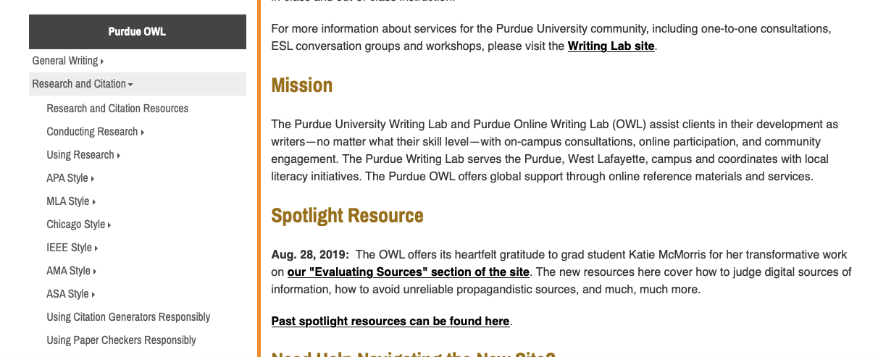

Slide 25
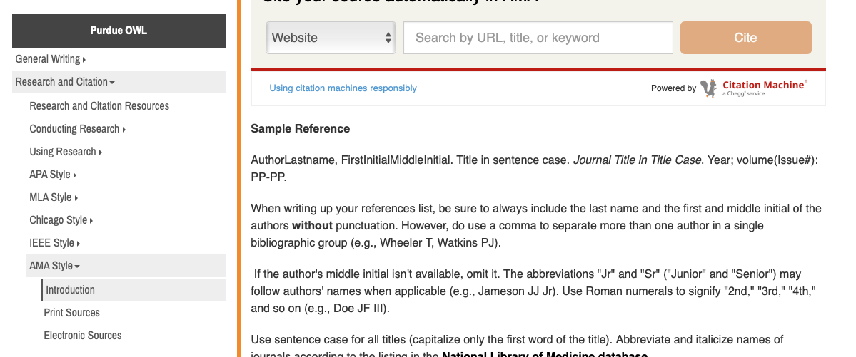

Slide 26
So, citations are hard…
I spent three hours with a professor going through dozens of citations for a professional publication
If it can help her, I can help you
You can email me your paper and ask if your citations are sound.
Credit: Randal Munroe

Slide 27
How to contact me
Email
Kathryn.zane@westliberty.edu
Phone
304-336-8534
Twitter
@Westlib_library
Stop by my office
Because homework doesn’t keep 8-4 hours

Slide 28
Wait, wait! Hold up! What if I need this awesome, totally relevant INFO IN THE FUTURE?
BAM! Download it from the library site: http://westliberty.edu/library

Slide 29
Go forward and make me proud

