Slide 1
MedExpress Vs. Emergency Room
The difference between getting stung by a bee and stepping on the hive

Slide 2
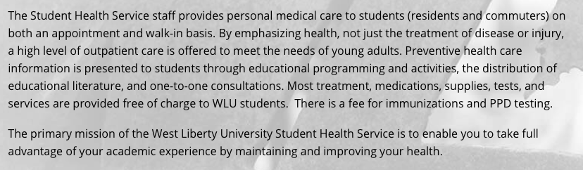
First: A Few Words About Student Health Services
From West Liberty’s Website

Slide 3
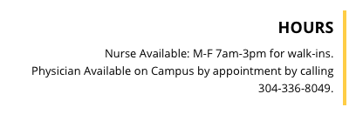
Consider Student Services
Services are greatly discounted, if not free to students
Doctor available by appointment
They also offer healthcare information

Slide 4
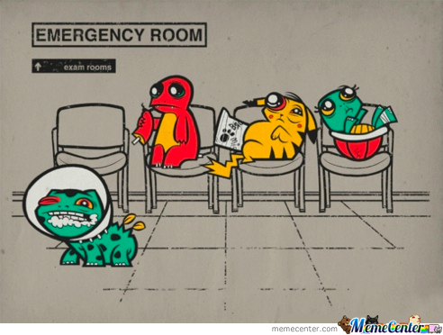
With My Luck, I’ll Be Sick At 3:30
There’s no way to plan illnesses or injuries
If it’s after hours, you need to know where to go
Some people feel nervous about seeing on campus health specialists
Some students have such tight/weird schedules that they can’t see the on campus clinic

Slide 5
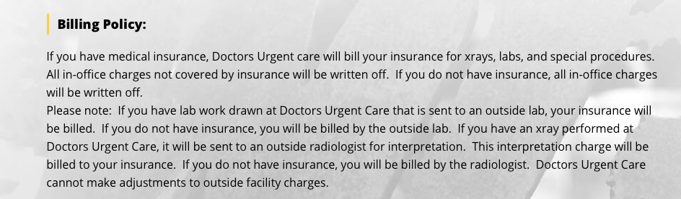
Doctor’s Urgent Care Is Listed On The Website as After Hours Care Provider
From West Liberty Website

Slide 6
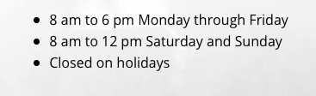
But There Are Some Considerations
The hours aren’t as good as MedExpress
They bill additionally for x-rays and lab work
MedExpress is open on holidays
Doctor’s Urgent Care Hours

Slide 7
What’s The Difference
MedExpress
Emergency room
Set hours, usually from 8AM – 8PM
A variety of typical services
Cheaper copay
Easier follow-up services
Some offer their own insurance plan as an alternative to traditional insurance
Reserved for serious issues
Much more expensive
Wider variety of scans and testing
Ability to hospitalize in case of further serious care needs
No real follow-up options

Slide 8
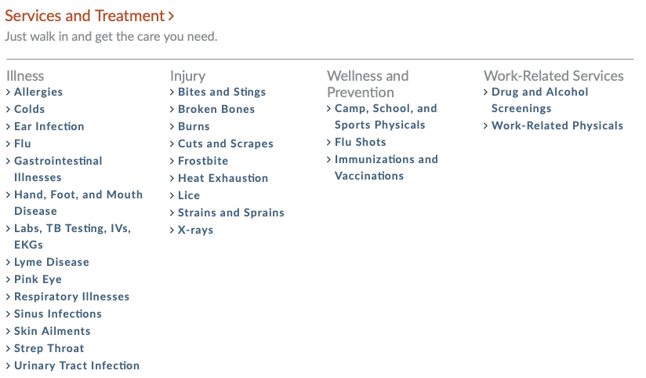
What Can MedExpress Do For You?
There’s more to MedExpress than just the occasional boo boo
Basic x-rays and lab work can be done without being referred to an actual hospital
You can get prescriptions for basic illnesses without waiting four hours

Slide 9
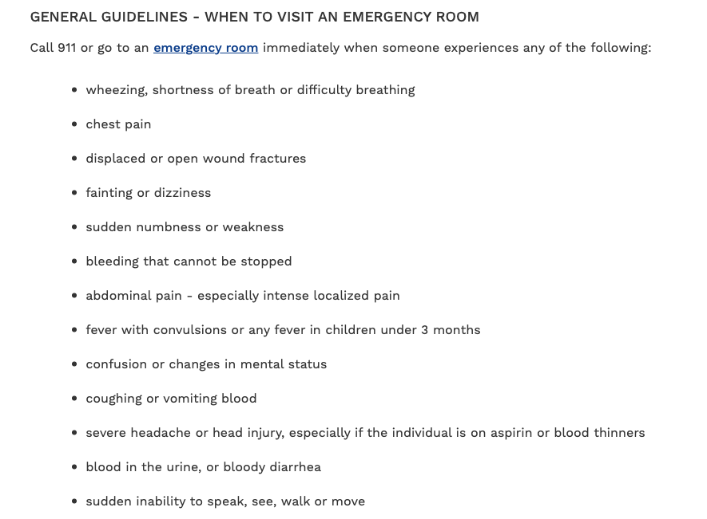
What Does The Emergency Room Offer
More options for bloodwork, testing, scans, and x-rays
Some conditions are too serious for MedExpress
  Convulsions
  Breathing issues
  Serious allergic reactions
  Some infections
  Complicated broken bones
  Blood that won’t properly stay in your body
  And many more
Taken from Beaumont.org

Slide 10
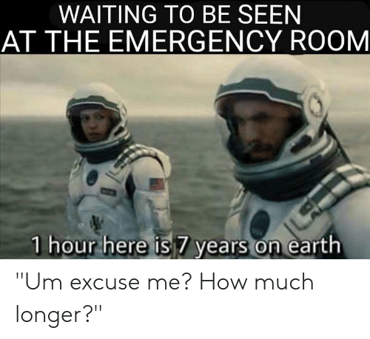
What to Bring When You Go
Your insurance card
Your ID
Your student ID for Doctor’s Urgent Care
The copay that’s due at time of service
Your insurance card usually has the copays listed on it

Slide 11

Billing Is Different for the ER
Unlike MedExpress where everything is covered by a copay, the Emergency Room is much more complicated
The bill is highly itemized:
  The ER visit
  Insurance copay
  The doctor consultation
  Lab work
  Xrays
  Radiologist
  Any other specialist that is consulted
  Ambulance if used

Slide 12

I Totally Can’t Afford It, But I Need It
You’re in luck!
Hospitals are required to administer care regardless of your ability to pay for it
They forgive bills for those in financial straits in return for tax write-offs from the government
Many facilities put together payment plans for those who don’t qualify
This includes care for expectant mothers who may be experiencing labor
The financial department of the ER can be contacted for the forms necessary to request assistance

Slide 13

OVMC Is Closed. Now What?
ER waiting times are outrageous.
Wheeling hospital is especially backed up
At the end of the presentation is a list of other hospitals
Weirton and Glen Dale are probably your best bets
Using Doctor’s Urgent Care and MedExpress during their open hours will help

Slide 14
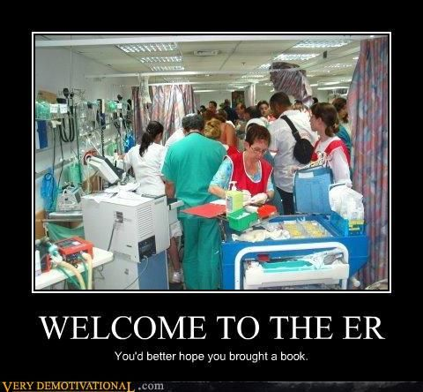
What Else Can You Do About ER Wait Times
Are you in a position to go to Washington Hospital or Allegheny General Hospital Washington campus?
Is Pittsburgh an option?

Slide 15
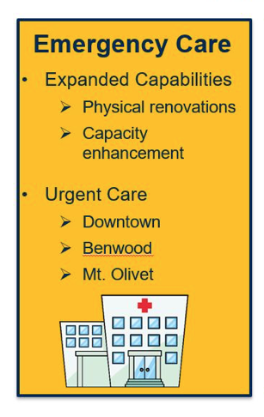
New Emergency Care Facilities in the Works
New facilities in downtown Wheeling, Benwood, and Mt. Olivet will help to offset the traffic through Wheeling Hospital
Hopefully will be put in place within the next six months

Slide 16
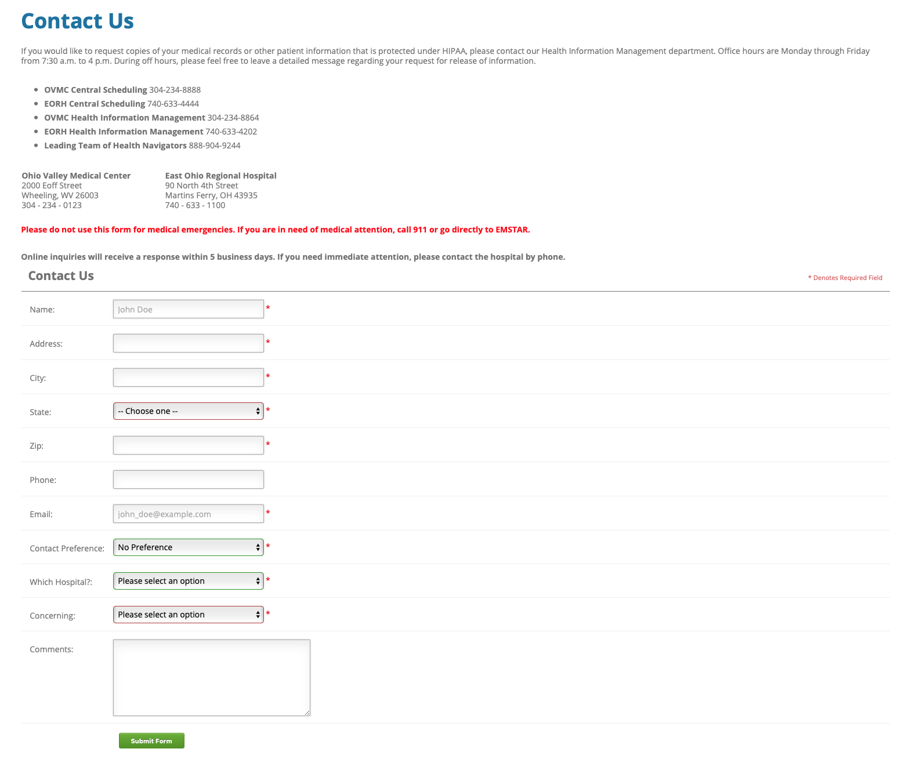
Medical Records
https://www.ovmc-eorh.com/contact/
Fill out the online form to gain your records
You’ll need your records in order to move to a new healthcare provider
OVMC is slammed with these requests at this time. Wait times will be longer
You don’t need to wait until you have your records to see a new doctor

Slide 17
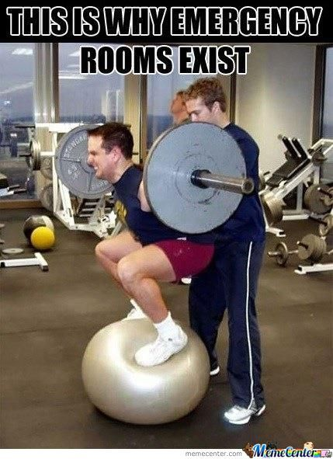
Privacy and HIPAA
You most certainly have the right to privacy when seeking medical aid.
Just because your parents have you on their insurance does NOT entitle them to view your medical records
As long as you are not a minor and your parents do not have power of attorney, you can keep your visits to any medical facility private

Slide 18
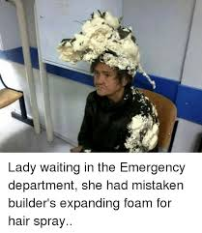
Other Private Testing
MedExpress does STD testing
This is especially meaningful to women who may not have access to the gynecologist back home
Again, your records are kept private

Slide 19
Where Can I Go?
MedExpress
Emergency Room
Wheeling
Elm Grove
Glen Dale
Weirton
Washington
Wheeling Hospital
Trinity
Reynolds Memorial
Washington Hospital
Allegheny Hospital in Washington

Slide 20
School Backed Locations
Doctor’s urgent care
Student Services
Wheeling
St. Clairsville
Shaw Hall Room 019

