Slide 1
Interested in Interest rates
Make it work for you, or be its slave. There’s no in between

Slide 2
A Few words from J. Reuben Clark jr.
Interest never sleeps nor sickens nor dies; it never goes to the hospital; it works on Sundays and holidays; it never takes a vacation; it never visits nor travels . . . it has no love, no sympathy; it is as hard and soulless as a granite cliff. Once in debt, interest is your companion every minute of the day and night; you cannot shun it or slip away from it; you cannot dismiss it; it yields neither to entreaties, demands nor orders; and whenever you get in its way or cross its course or fail to meet its demands, it crushes you.”

Slide 3
Understanding interest is key in being financially successful
There are many hidden pitfalls in dealing with interest
Compound interest is a really big deal
Know how to read your bills

Slide 4
Ok, what exactly is interest
Interest is a fee associated with borrowing money. In exchange for getting the money immediately, you, the borrower, agree to pay them more money until the debt is repaid.
When borrowing large amounts, you can pay for things like a house twice the original value in interest fees alone
Yes, some banks give you interest for your savings accounts, but these rates are so grossly low, they aren’t worth planning on

Slide 5
Interest Rates have a huge impact in how much they raise your payments
These amounts all originate from the amount of $5,000
The amount of interest and the length of time were altered to show that you can end up paying a lot more
From rediff.com

Slide 6
A little simpler
Raising the interest rates will raise your payments
Whenever you’re paying towards something, lower interest rates are better
Whenever someone is giving you money, higher interest rates are better

Slide 7
Compound interest
The interest adds to the previous amount + the interest it gained
In the space of 3 month, compound interest turned this bill from 30% interest to 33% interest. That doesn’t look like a lot, but that’s an additional $3,000 towards a $100,000 bill
Also, it continues to compound month after month until the amount is paid off

Slide 8
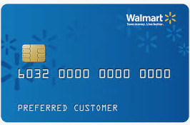
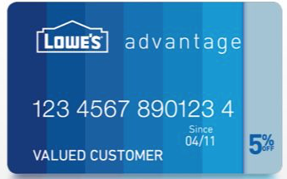
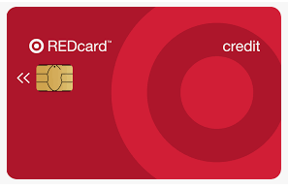
Not all cards and loans carry the same interest rates

Slide 9
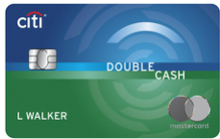
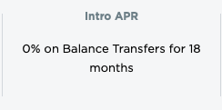
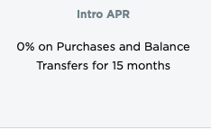
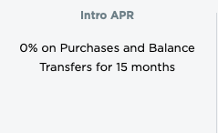
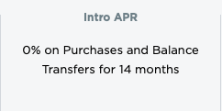
Some offer some sweet deals

Slide 10
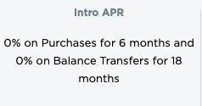
What Are Introductory Rates?
One the previous slide, some credit cards offer special rates for a short amount of time
Once that time span lapses, a much higher interest rate (15.24% to 24.24% for this card) comes into play
Beware: these cards tend to charge you the interest you saved if you don’t manage to pay off the card before the interest rates kick in
Also, the interest rate depends on your credit score

Slide 11
Interest can be a long game
When you buy a house, it’s going to rack up a lot of interest
In this case, a $100,000 mortgage will cost you an addition $93,256 by the time you pay it off in 30 years
This is when a good credit score comes into play

Slide 12
What if your score isn’t great?
The same exact loan, but with 7% interest instead of 5% interest
The interest paid is $139,509, which is about $40,000 more dollars.
The monthly payment is $665 instead of $537
What interest rate you get is heavily influenced by your credit score

Slide 13
How to help yourself with interest problems
Check the interest rates on your credit cards and switch to cards with lower rates
Maintain a high credit score (another session about this later)
Shop around banks, dealerships, and other lending offices to see which ones offer better rates
Work with payoff calculators to determine how length of time and different rates affect your payments

