Slide 1
Preparing to Design a Course
Presented by:
Cory Bougher, Instructional Designer
tinyurl.com/VCON23DesignCourse
Click the agenda segments to jump ahead!
Click here to make a copy for yourself.
Course Content Planner
Curating Content
Questions?
Pre-planning
Policies

Slide 2
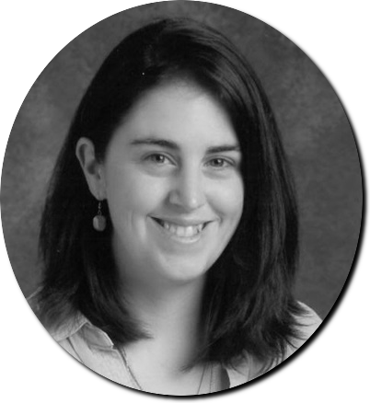
Who is the presenter?
Cory Bougher
WLU Instructional Designer
Former Indiana University Instructional Designer
Former Edtech Coach
Former Computer Science & Social Studies Teacher
Cory.Bougher@WestLiberty.Edu
Find me at LinkedIn

Slide 3
How will this session work?
Access slides on own device, can make a copy at tinyurl.com/VCON23Prepare
Ask questions, make comments in chat
This is a 50 minute session, no breaks

Slide 4
What are this session’s learning objectives?
Explain multiple reasons for thoroughly pre-planning a course
Explain the full course development cycle
Identify the purpose and write at least one strong CLO and MLO
State the Carnegie Unit formula for a credit hour
Explain the purpose of the Quality Matters rubric
Explain the purpose of a Course Content Planner
Select available instructional resources and copyright parameters

Slide 5
What is the WLU course development cycle?
Course/credit is approved by institution
1+ semester curating content by subject matter expert (SME)
1 semester building content by SME/instructional designer (hybrid/online)
Course should be reviewed internally using rubric for quality
Course officially offered to students
Course should be reviewed internally using rubric/refreshed within 5 years
Session Learning Objective: 2

Slide 6
Pre-Planning
Est: 10 min

Slide 7
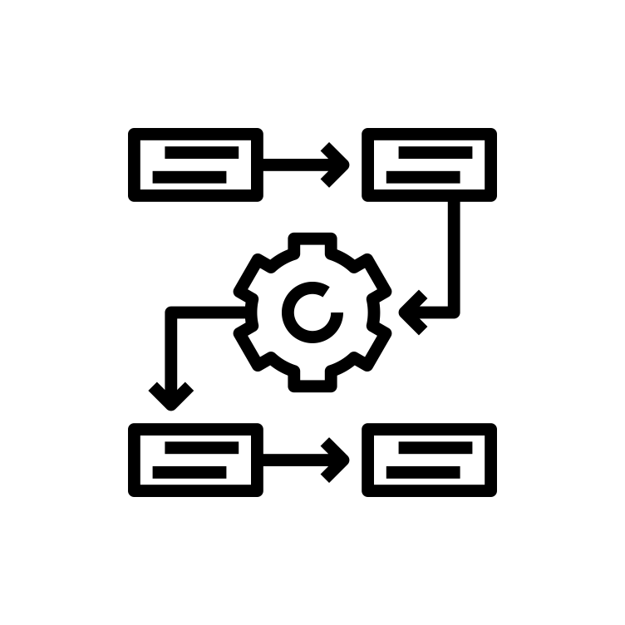
Pre-planning
Why Pre-Plan a Course?
Carefully throughout courses produce better student outcomes
Less stressful for faculty when entire course is built ahead of time
Easier to address issues with “broken” materials, schedule conflicts, and align to quality assurance standards
Developing a course only a week or so in advance is not a best practice - what happens if the developer is incapacitated?
Session Learning Objective: 1

Slide 8
Pre-planning
What is the point of the course?
Use official course description as guide
Program goals can also be used
Handful of goals become Course Learning Objectives (CLOs)
Use measurable verbs to describe objectives
Justifies why a student should take this course in their degree program
Session Learning Objective: 1

Slide 9
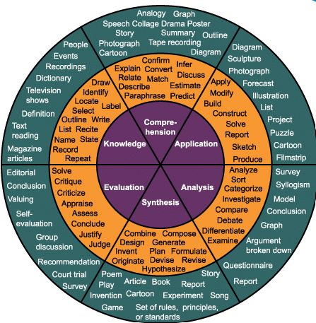
Pre-planning
What makes a strong course learning outcome (CLO)?
Specific and measurable
Good
Describe the interaction of disease states and pharmacological approaches
Describes broad desired learner mastery after successful completion of a course
Starts with action verb
Measurable
Vague and unmeasurable
Poor
Be aware of the relationship of diseases with pharmaceuticals
Check out a verb wheel based on Bloom’s Taxonomy
Session Learning Objective: 3

Slide 10
Pre-planning
How do I write a CLO?
Course Number
Action Verb
Specific Subject Content
Conditions or Resources
ENG 101, CLO3
Identify and create
writing elements
Such as thesis, topic/paragraph development, organization, transitions, introductions, and conclusions.
Session Learning Objective: 3

Slide 11
Pre-planning
What is the difference between CLO and MLO?
Course Outcome, Specific, Measurable
CLO4
Describe the interaction of disease states and pharmacological approaches
CLO = broad course outcomes
Explains why a student would enroll in course
MLO = specific module outcomes
Relates to specific assignments to build skills
Both are measurable, begin with verbs
Strive for higher levels of Bloom’s as course progresses
Specific version of CLO for Module 10
M10LO1
Explain how different medical approaches impact hormone dysfunctions (CLO4)
Session Learning Objective: 3

Slide 12
Pre-planning
How do I write a MLO?
Module, Number
Action Verb
Specific Subject Content
Conditions or Resources
ENG 101, M2LO3
Arrange
body paragraphs
in a logical order.
ENG 101, M6LO5
Write
about sources
in short writing.
ENG 101, M14LO3
Identify
multiple logical fallacy
examples.
Session Learning Objective: 3

Slide 13
Policies
Est: 10 min

Slide 14
Policies
What is a Carnegie Unit?
Defines a semester unit of credit = minimum of 3 hrs of work/week for a semester (15 wks)
1 unit of credit = 3 hours of student work/week
1 hour lecture + 2 hours of homework or 3 hours of lab
Applies to all course delivery formats
Session Learning Objective: 4

Slide 15
Policies
What is WLU’s Credit Hour Policy?
Credit Hour Policy, III. B: The expectation of contact time inside the classroom and student effort outside the classroom is the same in all formats of a course whether it is fully online, a hybrid of face-to-face contact with some content delivered by electronic means, or one delivered in lecture or seminar format.
2700 minutes of instruction for 3 credit hours courses
5400 minutes of student work for 3 credit hours courses
Session Learning Objective: 4

Slide 16
Policies
How long is a module under Carnegie?
There is a misconception that lesser modules means a lesser amount of instruction and student work. Under credit hour guidance, this is not true - it is the same amount of work structured in a different pace.
16 modules = 3 crs
8 modules = 3 crs
6 modules = 3 crs
8 hours each
16 hours each
22 hours each
Traditional Accelerated Very Accelerated
Session Learning Objective: 4

Slide 17
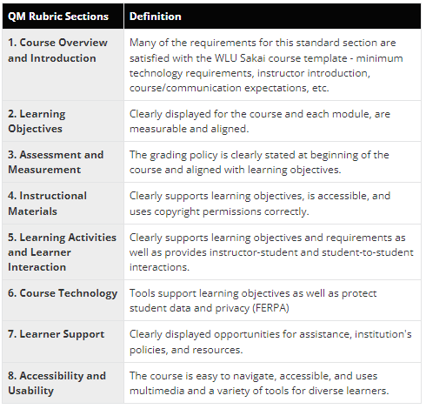
Policies
What is a Quality Matters Rubric?
Internationally recognized, peer review process for fully online/hybrid courses
Rubric has 8 overall standard categories (with several standards each)
Goal is to met 85%+ of each standard for certification
Check out QM Rubrics! 7th edition will be available June 2023

Slide 18
Course Content Planner
Est: 10 min

Slide 19
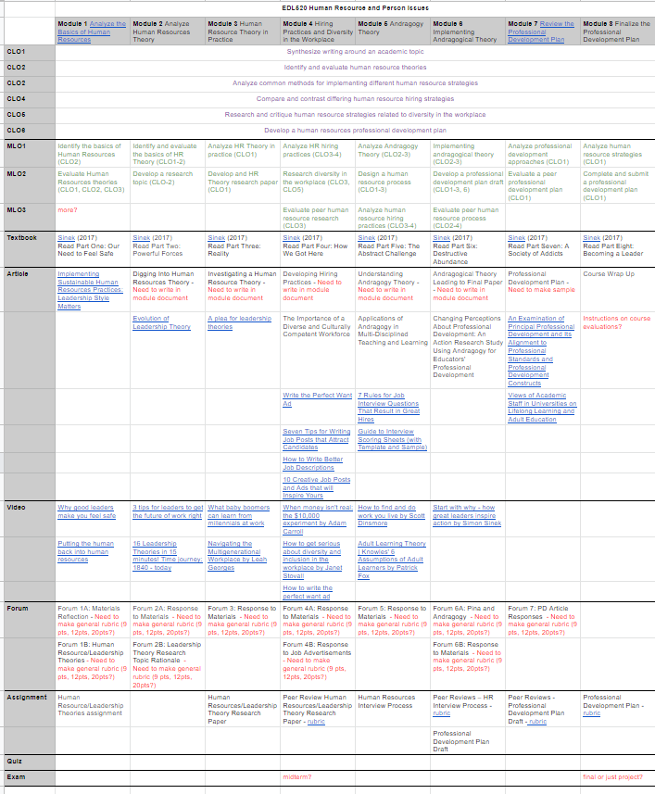
Course Content Planner
How do I start organizing my content?
Course Content Planner template (6, 8 or 16wk)
Can use long term to put in links, notes, to-do items, etc
Gives overview to help you stay aligned to learning objectives, compare work loads across modules, determine when students may need notifications for upcoming assignments
Click sample to see more details
Session Learning Objective: 6

Slide 20
Course Content Planner
Link to Module template document
Course Title
Course Learning Objectives
Module Learning Objectives
Textbook
Articles
Videos
Forum Topics
Assignments
Quizzes/Exams
Session Learning Objective: 6

Slide 21
Course Content Planner
How do I pace the course?
Is course 6, 8, or 16 weeks?
Consider a module as a packaged lesson for the week
Start Module 1 with introductions, overviews, etc
End Module 8 (or Module 16) with final project, exam, etc
All other modules are content supporting CLOs
Session Learning Objective: 6

Slide 22
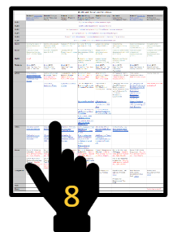
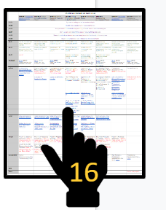
Course Content Planner
How do I start to use the Course Content Planner?
Create CLOs (4-7)
Identify focus topics
Arrange topics in logical order across modules (8/16)
Create specific MLOs (2-5) for each module topic
Design activities that utilize a module’s MLOs
Create or curate instructional materials that support the specific module activities
Get a planner template
Session Learning Objective: 6

Slide 23
Curating Content
Est: 10 min

Slide 24
Curating Content
What does each module need?
Instructor-student interaction
Examples:
Textbook summaries
Visual presentations
Instructional videos
Podcasts
rubrics
Student-Student interaction
Examples:
Forums
Blogs
Wikis
Hypothes.is
Peer Reviews
Session Learning Objective: 6

Slide 25
Curating Content
What resources can I use?
WLU Library Database - academic articles open to all WLU members
Publisher content that imports to Sakai
Open Educational Resources (OER)
Youtube videos
Create your own
WLU Office of eLearning instructional designers
Find materials by subject/level
Session Learning Objective: 7

Slide 26
Curating Content
What is copyrighted?
All material created subject to copyright laws
Publishers may limit how instructors give material to students
Direct students to WLU Library Database link to access articles
If unavailable, contact author directly for permission
Keep response on file in Sakai Resources folder
Then PDF articles can be posted in Sakai
Find copyright information and open sources
Session Learning Objective: 7

Slide 27
Curating Content
How should I assess learning?
All activities should measure MLOs
Not every activity should be gradebook points (pulse/comprehension)
Informal vs Formal - need a mix so everything is not high stakes for students and for instructors to correct misconceptions in real time
Hands-on is highest demonstration value
Join 1:00pm Edtech Tools session for engaging assessment tools!
Informal ← → Formal
Session Learning Objective: 7

Slide 28
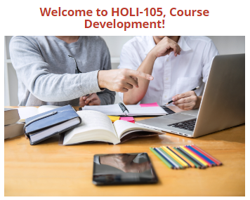
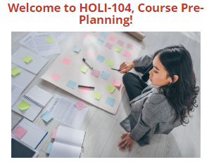
Curating Content
What are the next steps?
Complete* in-depth free Sakai LMS course series over entire course development from start to finish
Submit request for new course development with WLU Office of eLearning
Can also request assistance on course refreshes and evaluations, edtech instructional tools/materials, etc
Contact presenter for more info!
Session Learning Objective: 2

Slide 29
Questions
Questions or Feedback?
How did I do? Please submit an evaluation for this session!

