Slide 1
Enhance Your Courses with Edtech Tools
Presented by:
Amanda Alford, Educational Technologist
Cory Bougher, WLU Instructional Designer
tinyurl.com/VCON23edtech
Click the agenda segments to jump ahead!
Click here to make a copy for yourself.
Gamification
Collaboration & Assignments
Authentic Assessments
Questions?

Slide 2
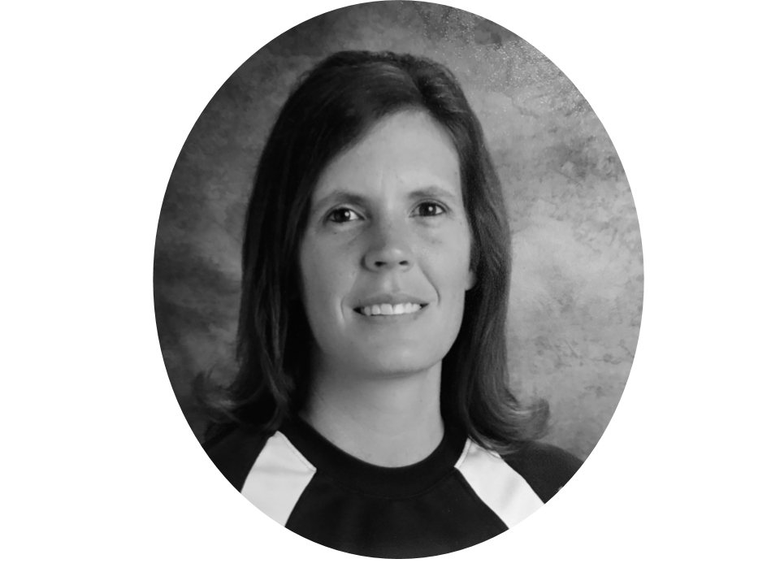
Who We Are
Amanda Alford
Educational Technologist
Former Edtech Coach
Former Science Teacher
facingyourfears@icloud.com
Find me at Linkedin
Cory Bougher
WLU Instructional Designer
Former Edtech Coach
Former Computer Science & Social Studies Teacher
Cory.Bougher@WestLiberty.Edu
Find me at LinkedIn

Slide 3
How will this session work?
Interactive - can use another tab or mobile device
6 tools presented in about 30 minute mini sessions
Ask questions, make comments in chat
2 breaks built in since this is a two hour session
This is a “speed-dating” session of tools from a student’s view. We will not be covering a full set-up. If you would like in-depth assistance, contact the WLU Office of eLearning!

Slide 4
What are this session’s learning objectives?
Use Kahoot and Quizizz for interactive activities.
Use Google Jamboard, Padlet, and Mindmeister for collaboration and content creation.
Explain the benefits of using interactive assessments and presentations.
Encourage student engagement with Flipgrid.
Integrate tools into instruction and learning management systems.
Consider ethical and privacy implications of tool use.

Slide 5
Gamification
Est: 30 min

Slide 6
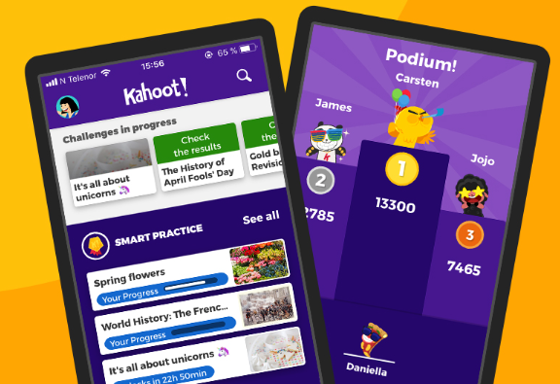
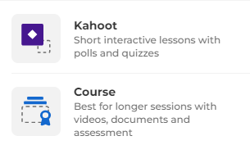
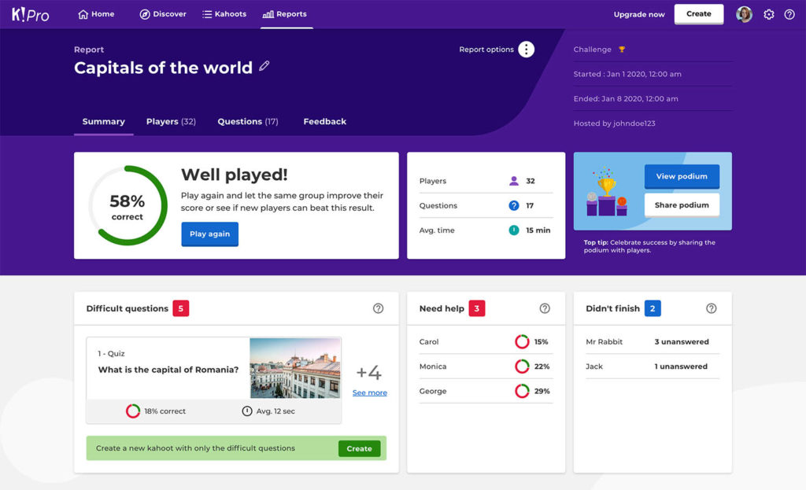
Gamification
Want to make review a game?
Free account
Make graded quizzes, course reviews with resources
Can be played live, virtual live, or assigned as homework
Includes data by various markers
Use phone or computer.
We will play a short game at kahoot.it
Session Learning Objective: 1

Slide 7
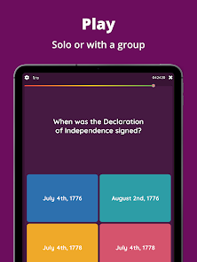
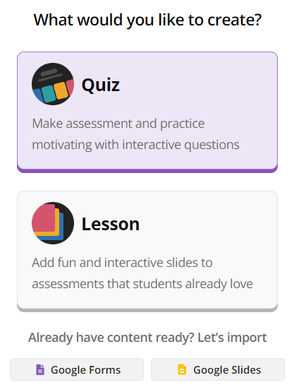
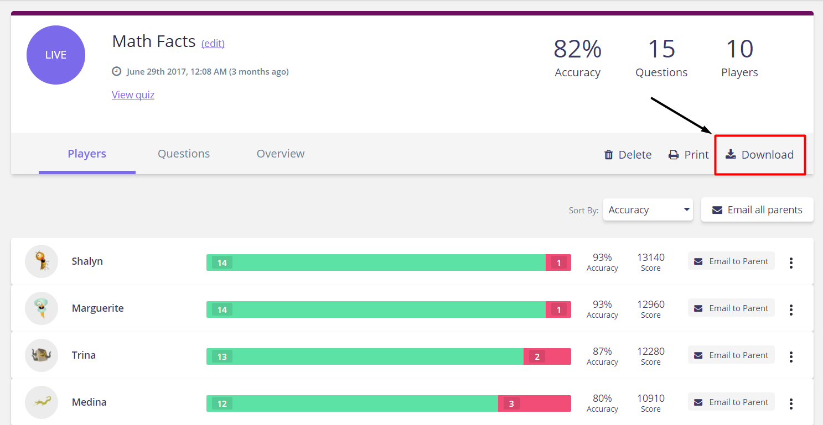
Gamification
Want to make review a game?
Free account
Make graded quizzes, lessons with embedded questions, or flashcards
Can be played live, virtual live, or assigned as homework
Includes data by various markers
Use phone or computer.
We will play a short game at joinmyquiz.com!
Session Learning Objective: 1

Slide 8
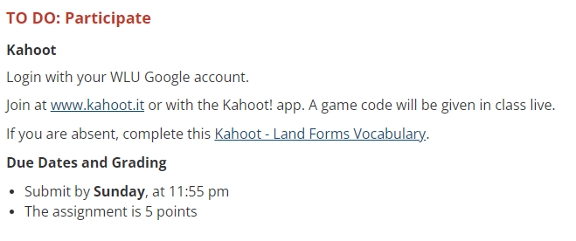
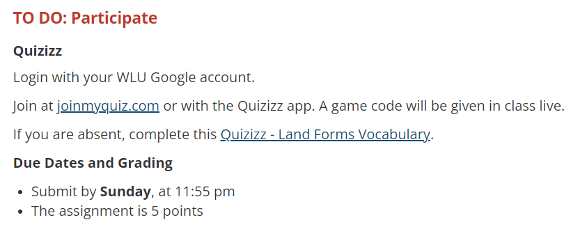
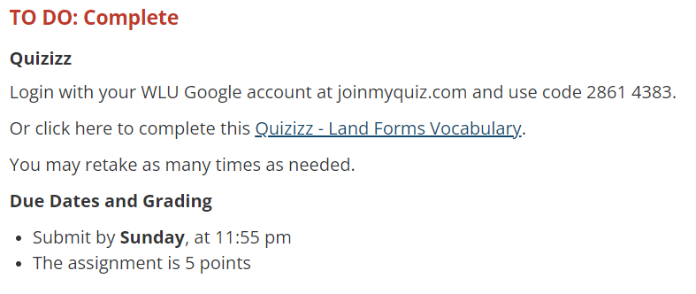
Gamification
Example of live versions in Sakai
Example of assignments in Sakai
Link is already set to “anyone with link can access”
No items to submit in Sakai
Session Learning Objective: 1, 3

Slide 9
Questions
Take a 5 min break!

Slide 10
Collaboration & Assignments
Est: 30 min

Slide 11
Collaboration & Assignments
Need a digital whiteboard?
create free with Google account, can share with anyone regardless of accounts
20 frames per jam with 50 simultaneous collaborators
can download as PDF or image or share live link for assignment
Ideas for math, human anatomy, metacognition, foreign language
Jamboard overview
Click image to access sample jamboards we will try in this session!
Session Learning Objective: 2, 3

Slide 12
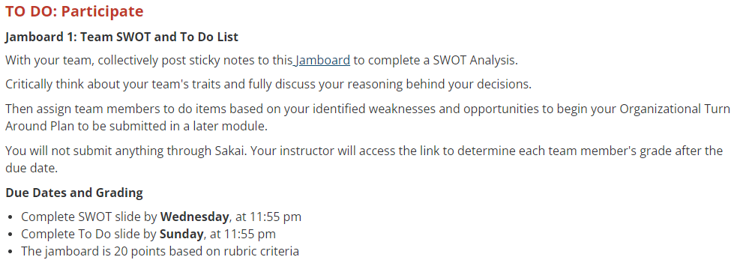
Authentic Assessments
Example of Jamboard activity in Sakai
Link is already set to “anyone with link can edit” (students and instructor)
No items to submit in Sakai
Session Learning Objective: 2, 3, 5

Slide 13
Authentic Assessments
Example of Jamboard assignment in Sakai
Edit hyperlink to force Google copy
Students submit PDF file in Sakai
Session Learning Objective: 2, 3, 5

Slide 14
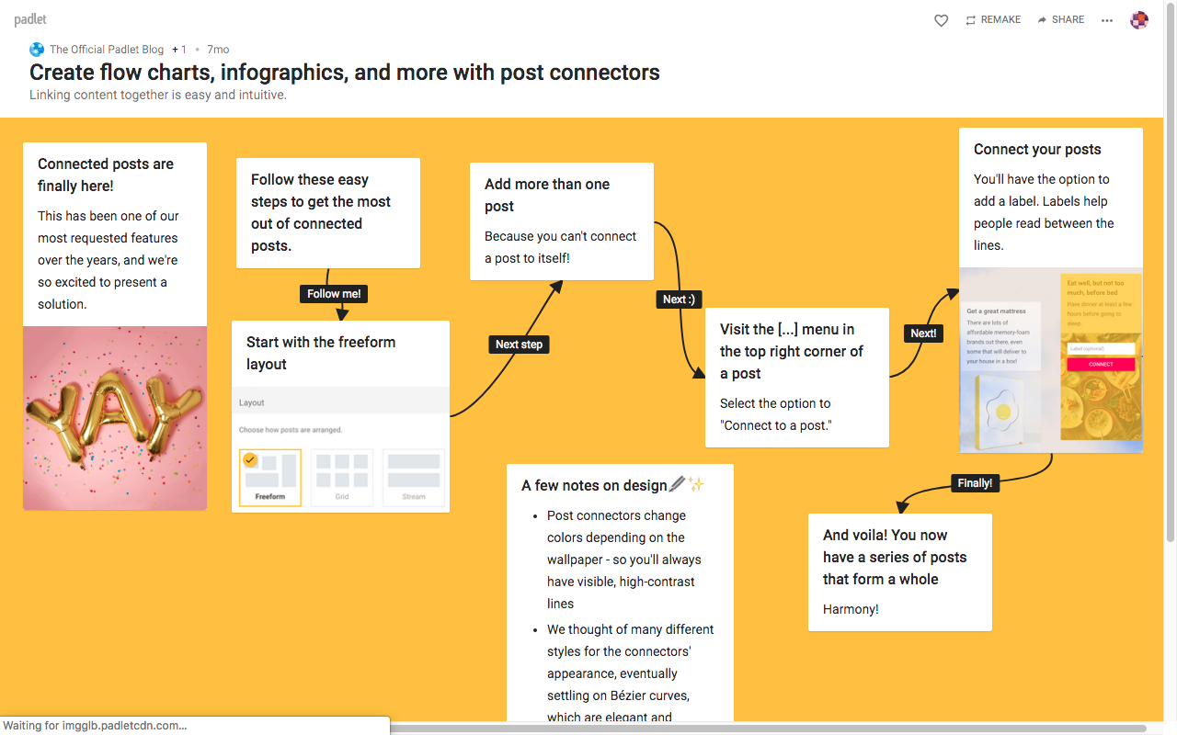
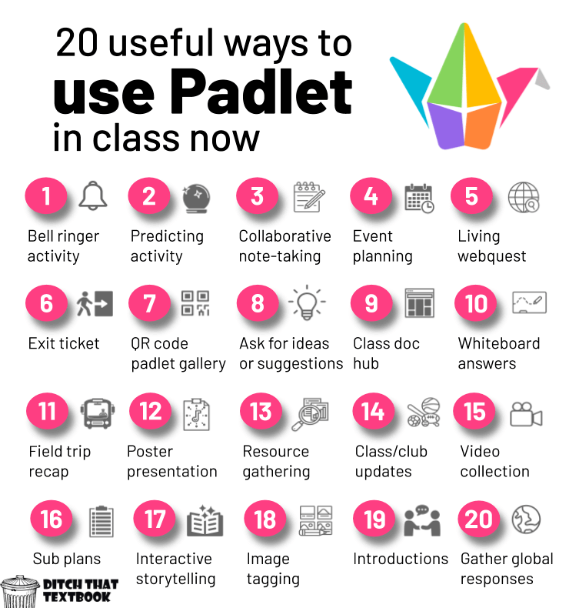
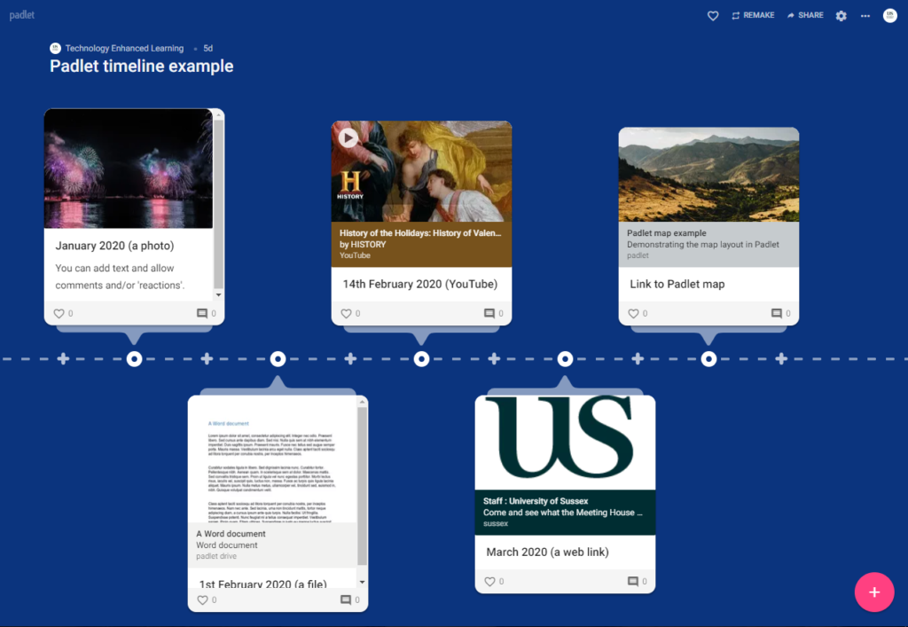
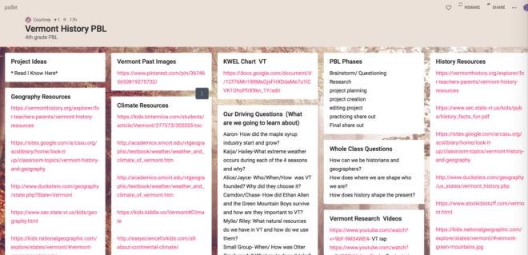
Collaboration & Assignments
Want to brainstorm collaboratively?
Free account with 3 padlets
Collaborative workspace for group projects and assignments
Brainstorming, note-taking, discussion, feedback, presentations
Use computer.
Participate in this Padlet! And this one!
Watch how-to video!
Click images to read more about examples!
Session Learning Objective: 2, 3

Slide 15
Authentic Assessments
Example of Padlet assignment in Sakai
Hyperlinked with any user can access
Students do not submit in Sakai
Session Learning Objective: 2, 3, 5

Slide 16
Collaboration & Assignments
Take a 5 min break!

Slide 17
Authentic Assessments
Est: 30 min

Slide 18
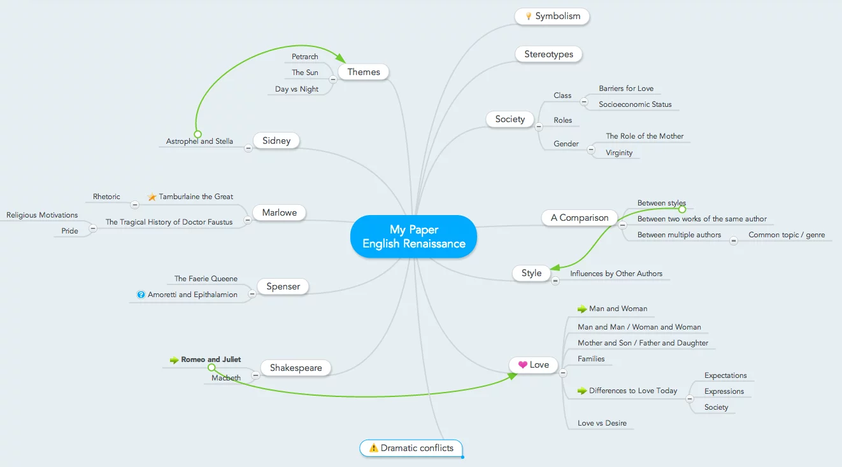
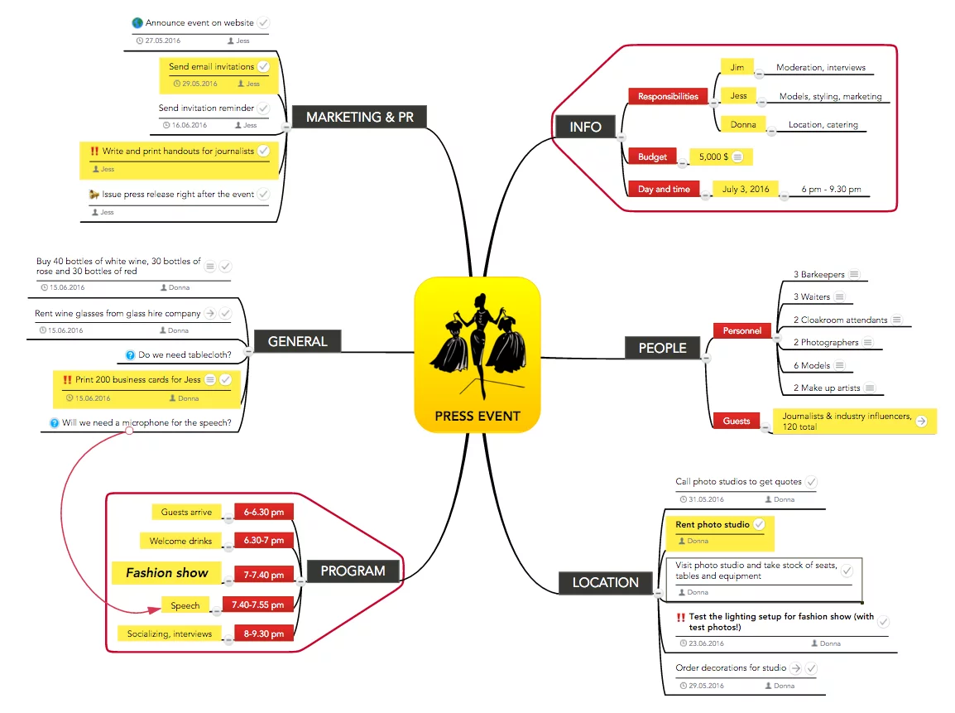
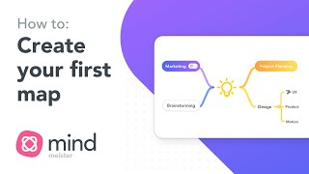
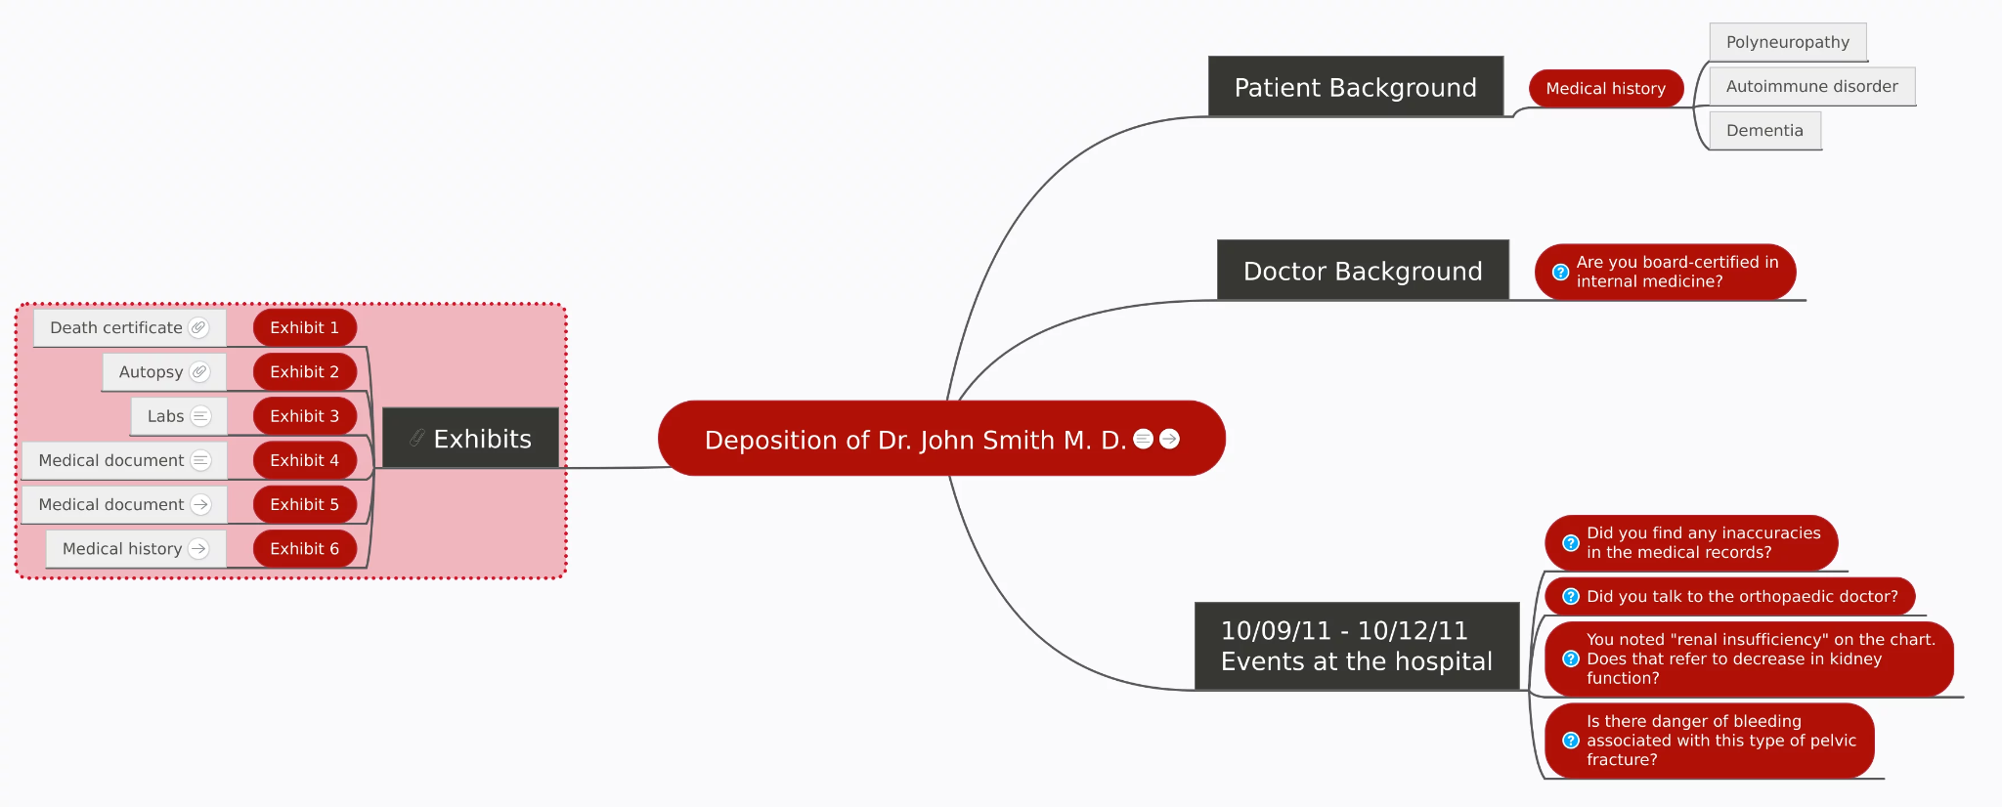
Authentic Assignments
Need to brainstorm?
Free account
Digital brainstorm & flowchart tool
Doesn’t run out of space, can rearrange bubbles, clean appearance, can collaborate, hyperlink, use images
Use for writing & event planning, notetaking, UX design, meeting agendas, onboarding, etc
WLU has template
language to MM
activities in
Sakai
Watch how-to video!
We will group edit this mind map!
Session Learning Objective: 2

Slide 19
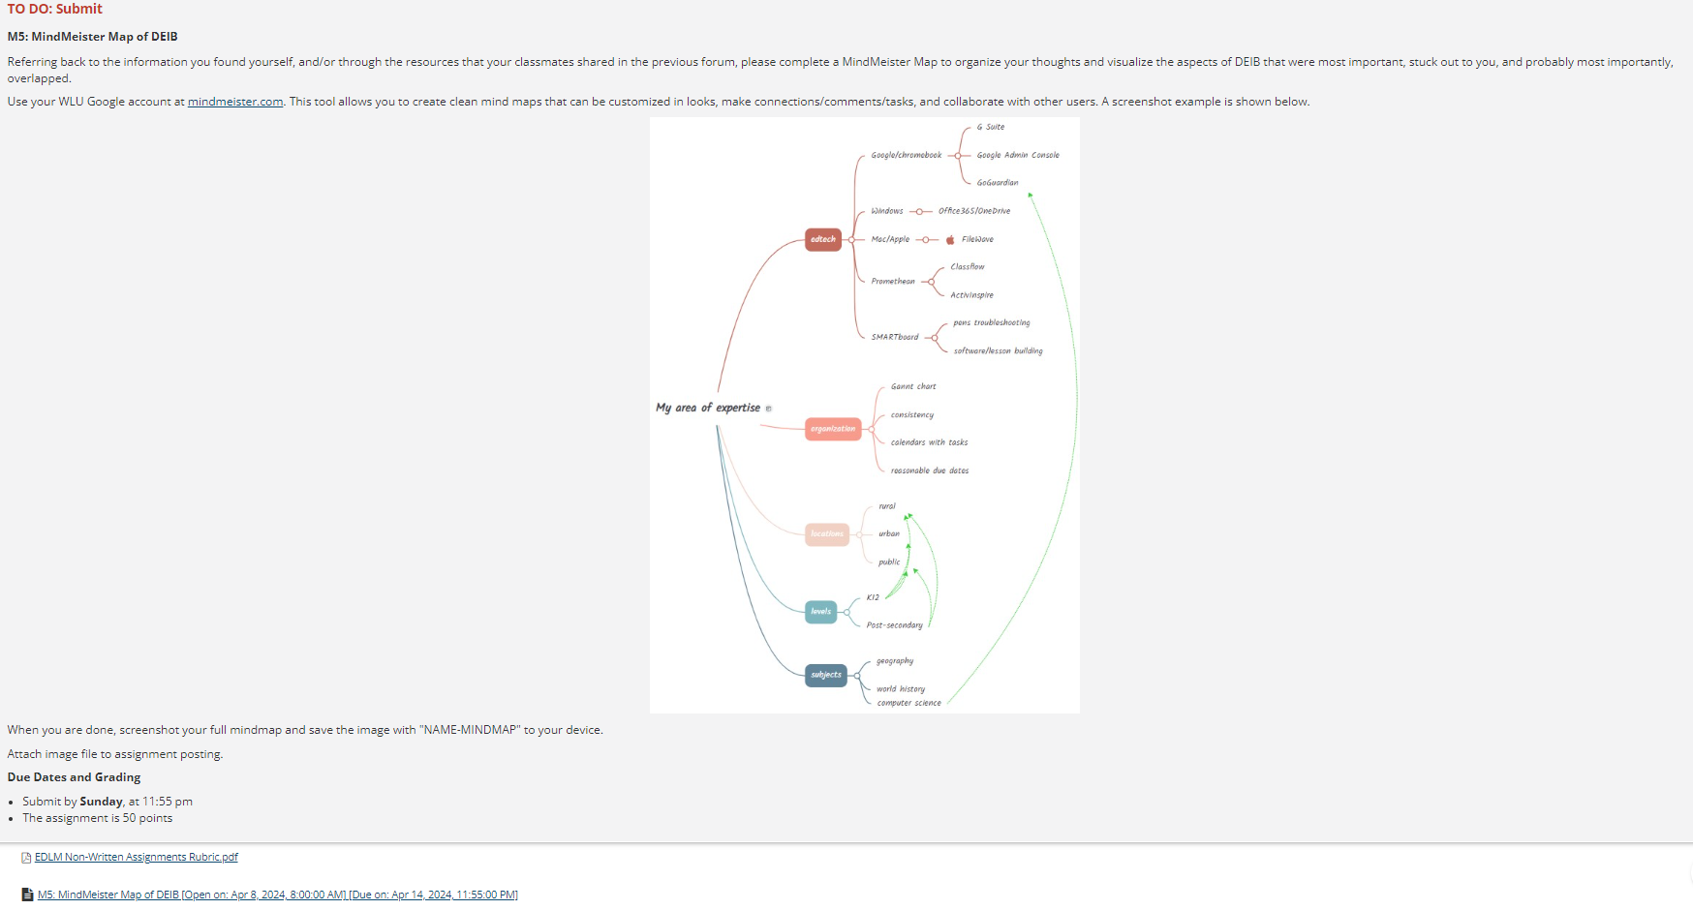
Authentic Assessments
Example of MindMeister assignment in Sakai
Students submit image file in Sakai
Session Learning Objective: 2, 5

Slide 20
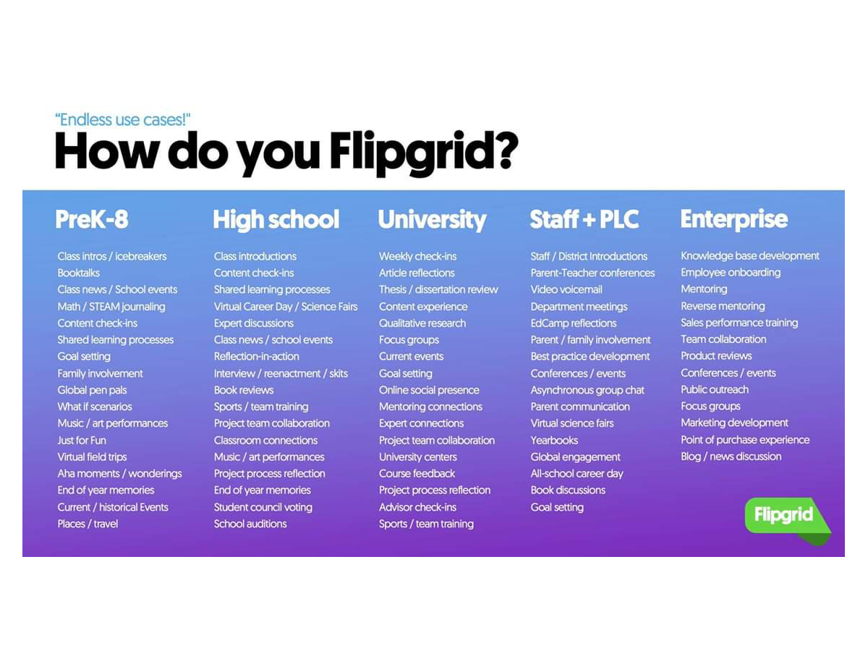
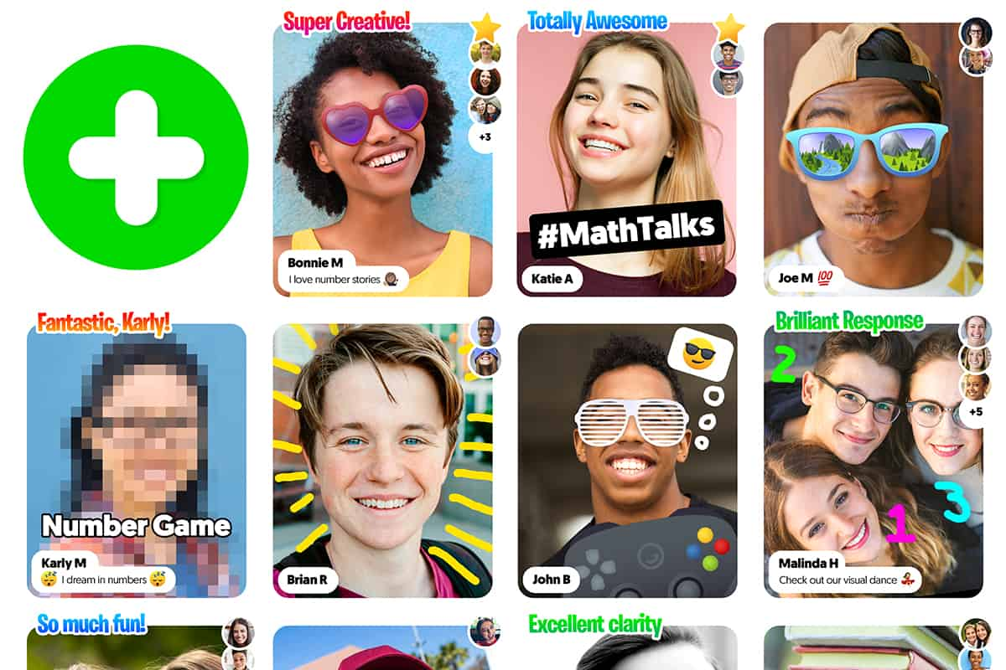
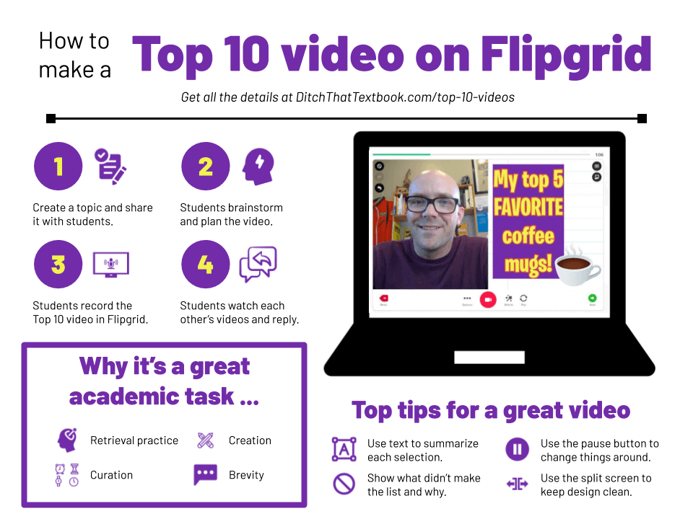
Authentic Assignments
Need authentic assessments?
Free account
Formative assessment tool providing feedback and encouraging peer-to-peer feedback
Hard to cheat at short speaking
Facilitate asynchronous or synchronous discussions, share multimedia resources, and provide feedback
Customize the settings, such as video length, response type, and moderation
Click HERE to join our group.
Click images to read more about examples!
Session Learning Objective: 4, 6
Notes:
Getting started link - https://help.flip.com/hc/en-us/articles/360051539934

Slide 21
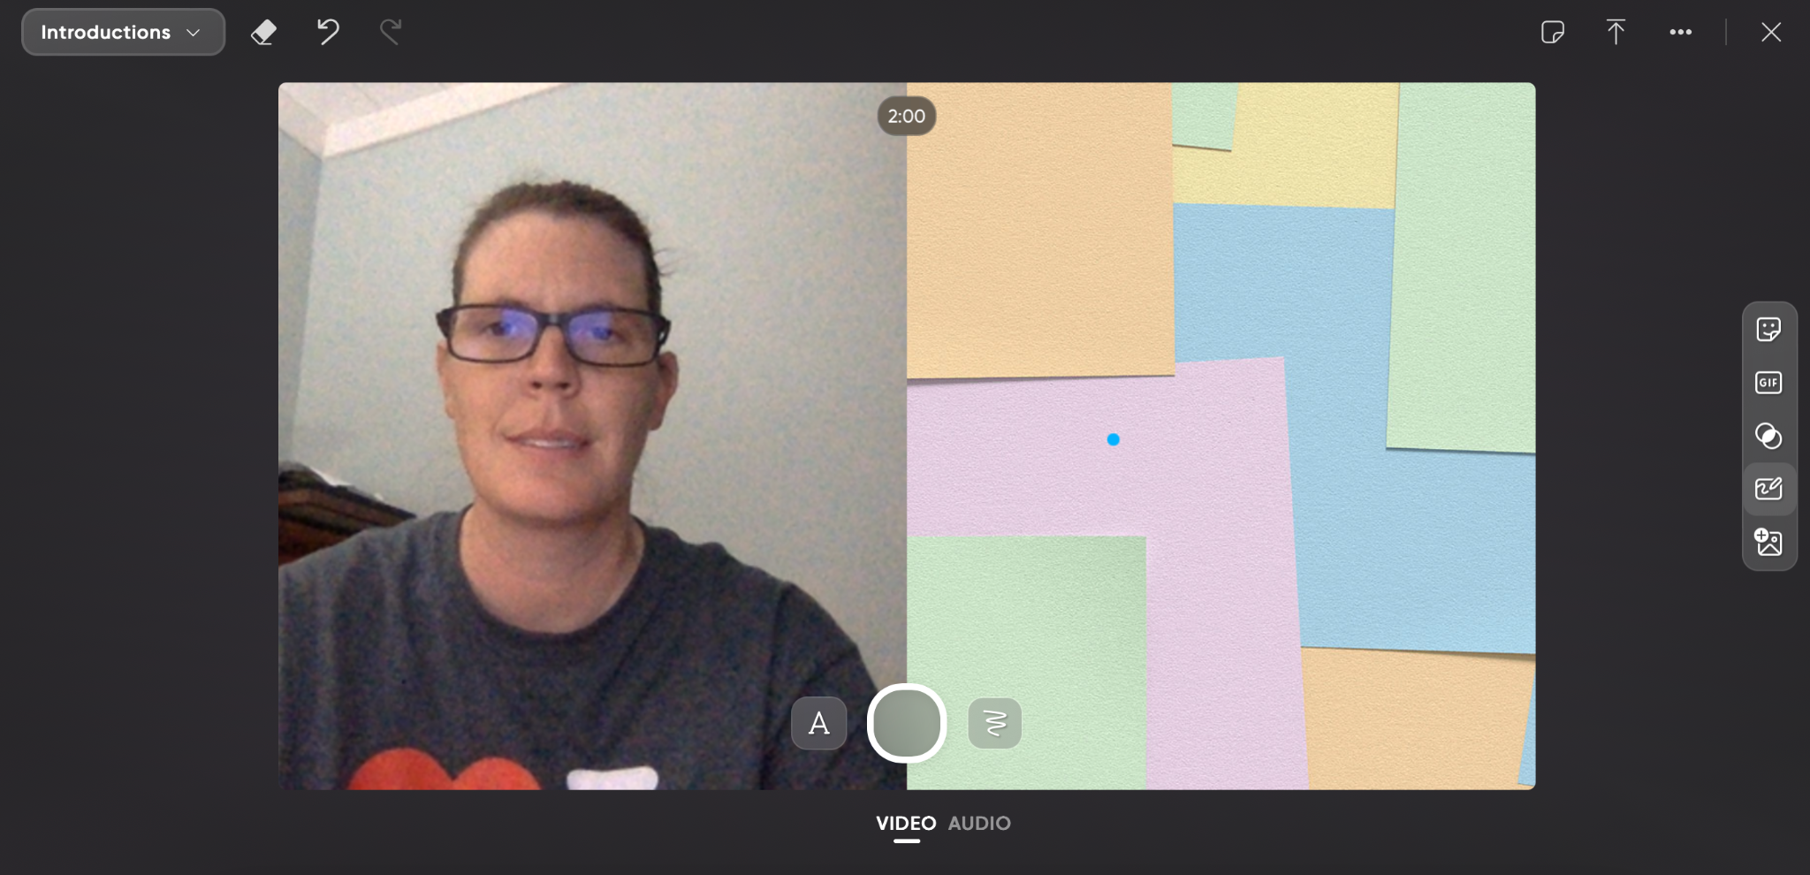
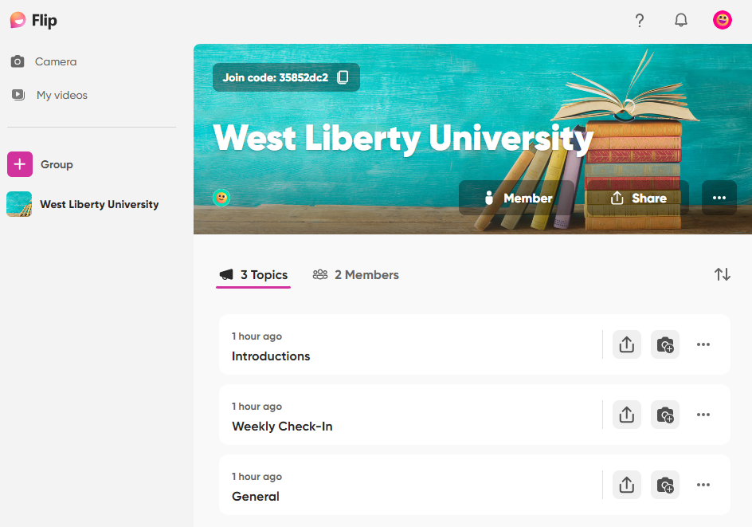
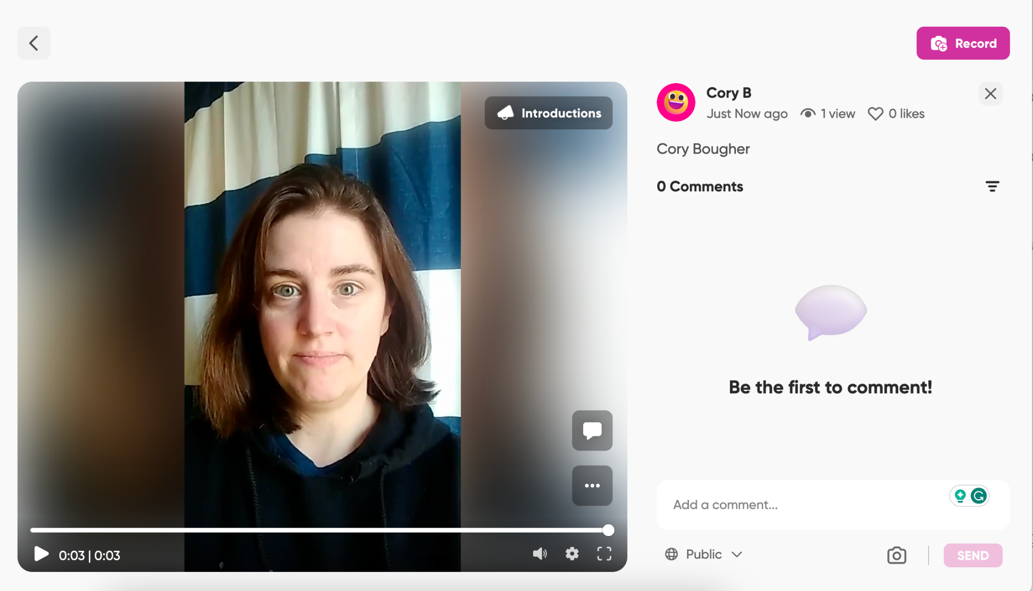
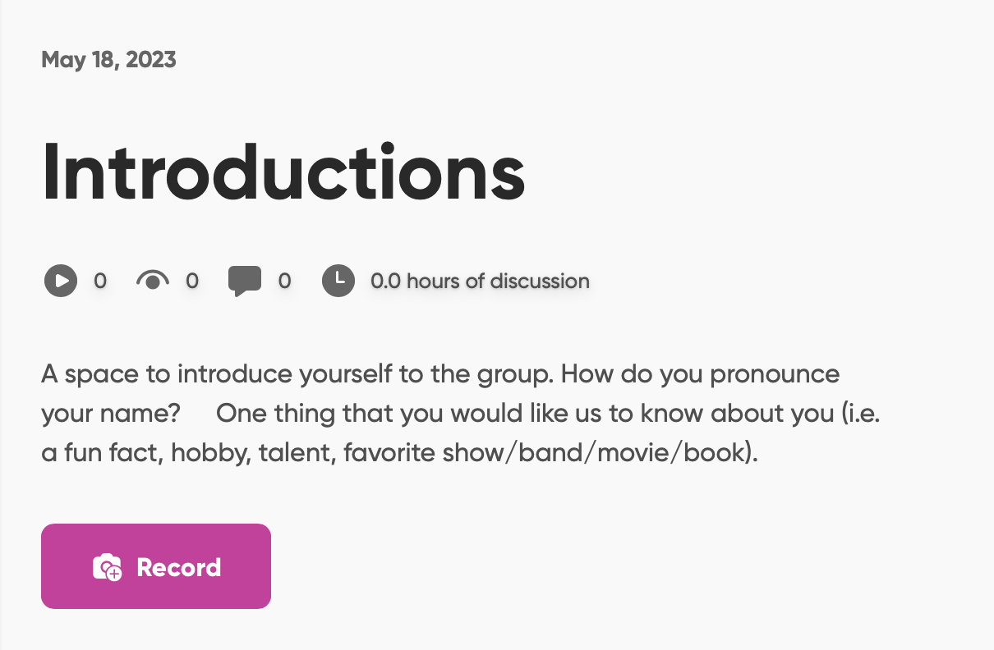
Authentic Assessments
Give Flip camera permissions
Session Learning Objective: 4, 5, 6

Slide 22
Authentic Assessments
Example of Flip assignment in Sakai
Students do not submit anything in Sakai
Clear parameters for video submissions
Session Learning Objective: 2, 5

Slide 23
Questions
Questions or Feedback?
How did I do? Please submit an evaluation for this session!

