Slide 1
Strategies and Resources for Engaging Students with Disabilities
Chris McPherson
VCON 2022

Slide 2
Points of Emphasis
Course Content
Engaging Students
Facilitating Accommodations
Additional Resources
Q&A

Slide 3
Orlando Bloom
“Creativity is the key for any child with dyslexia, or for anyone for that matter. Then you can think outside of the box. Teach them anything is attainable. Let them run with what you see is whatever they need to run with.”

Slide 4
Accessible Course Content
Documents/Resources
Word
PDF
PowerPoints
Videos
Close Captioning
Images
Alt Text
Tables
Google Docs – Accessibility Settings (Screen Reader Support)
Text Links

Slide 5
Documents/Resources
Word – Accessibility Checker
PowerPoints – Accessibility Checker; Subtitles/Captions
PDF - Creation

Slide 6
Videos
Closed Captioning Available

Slide 7
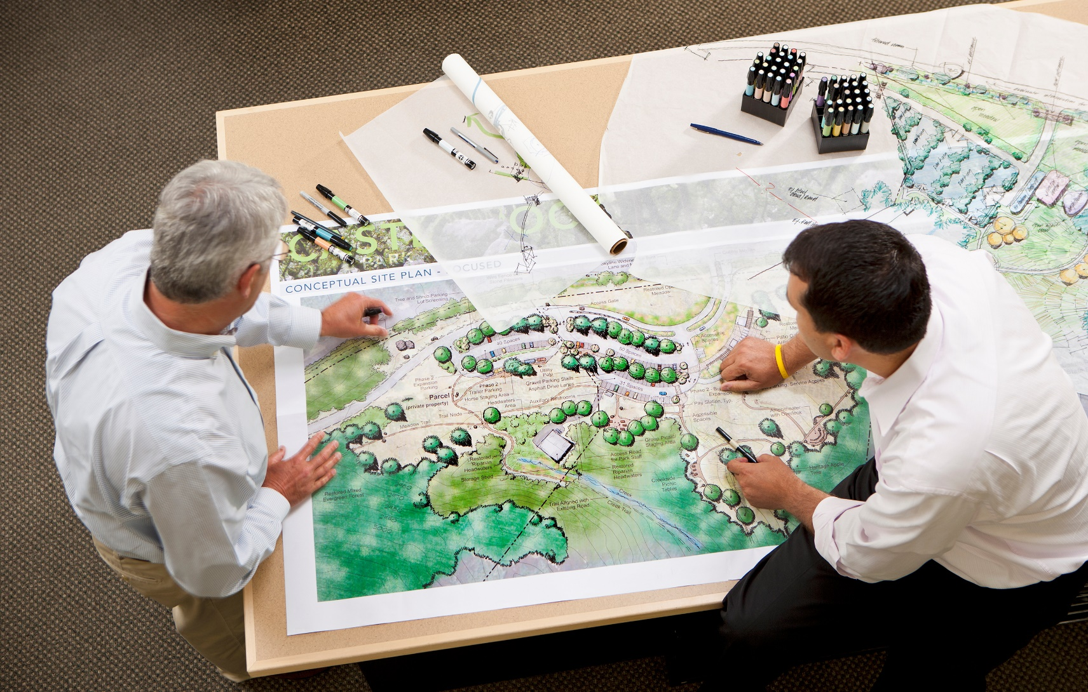
Images
Alt Text

Slide 8
Tables
Reading Order
Merged/Split Cells

Slide 9
Google Docs

Slide 10
Text Links
All about the description

Slide 11
Engaging Students
Different learning need/preferences
Visual – Does a non-seeing student still have access to meaningful visual content?
Auditory – Can a student that is hard of hearing still engage with audio content?
Reading/Writing – How easily can a student utilize a read-aloud tool with course documents/resources? Do students understand Microsoft 365 and other accessibility tools on their OS?
Kinesthetic – Are additional activities available that may help a hands-on learning style? If someone had a physical disability that hindered this, how would they engage?

Slide 12
Cui Bono?
“In the online format, we can make things more accessible to students, and the more that we do that proactively, it’s not only benefiting students with disabilities, but all students.”
— Nicholas Gelbar
(Psychologist, Educational Testing and Consulting)

Slide 13
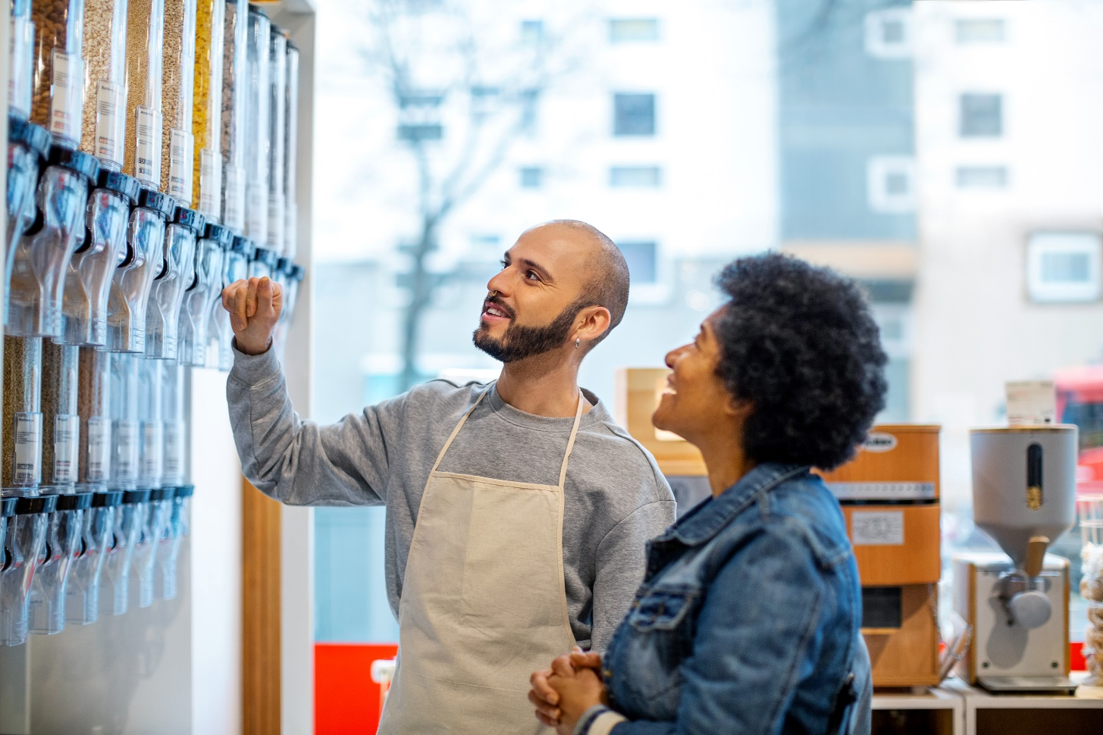
Facilitating Approved Accommodations
Process
Student Feedback
What if I don’t know what to do?

Slide 14
Additional Resources
Sharing information for students with disabilities - but any student can benefit
Online Learning Strategies for Students with Disabilities
What I Wish Someone Told Me BEFORE Taking Online Classes
7 TIPS FOR SUCCESS WHEN TAKING ONLINE COURSES
Teaching an Accessible Online Course

Slide 15
References
College Students With Disabilities on Online Learning Transition
How to Get the Transcript of a YouTube Video
Listen to Your Word Documents
Make your Excel documents accessible to people with disabilities
Online Learning Strategies for Students with Disabilities

Slide 16
References
7 TIPS FOR SUCCESS WHEN TAKING ONLINE COURSES
Teaching an Accessible Online Course
University of Washington Accessible Technology Webpage
What I Wish Someone Told Me BEFORE Taking Online Classes
Present with real-time, automatic captions or subtitles in PowerPoint

