Slide 1
Travel Settlements

Slide 2
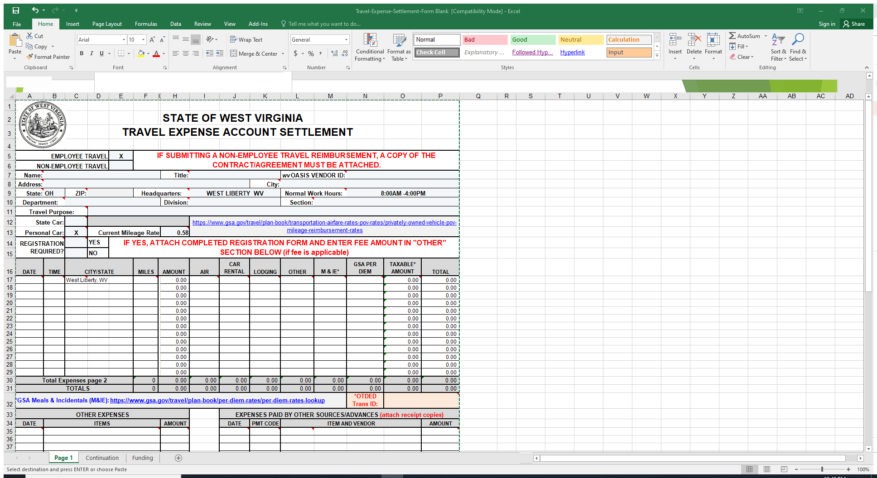
New Travel Expense Form

Slide 3
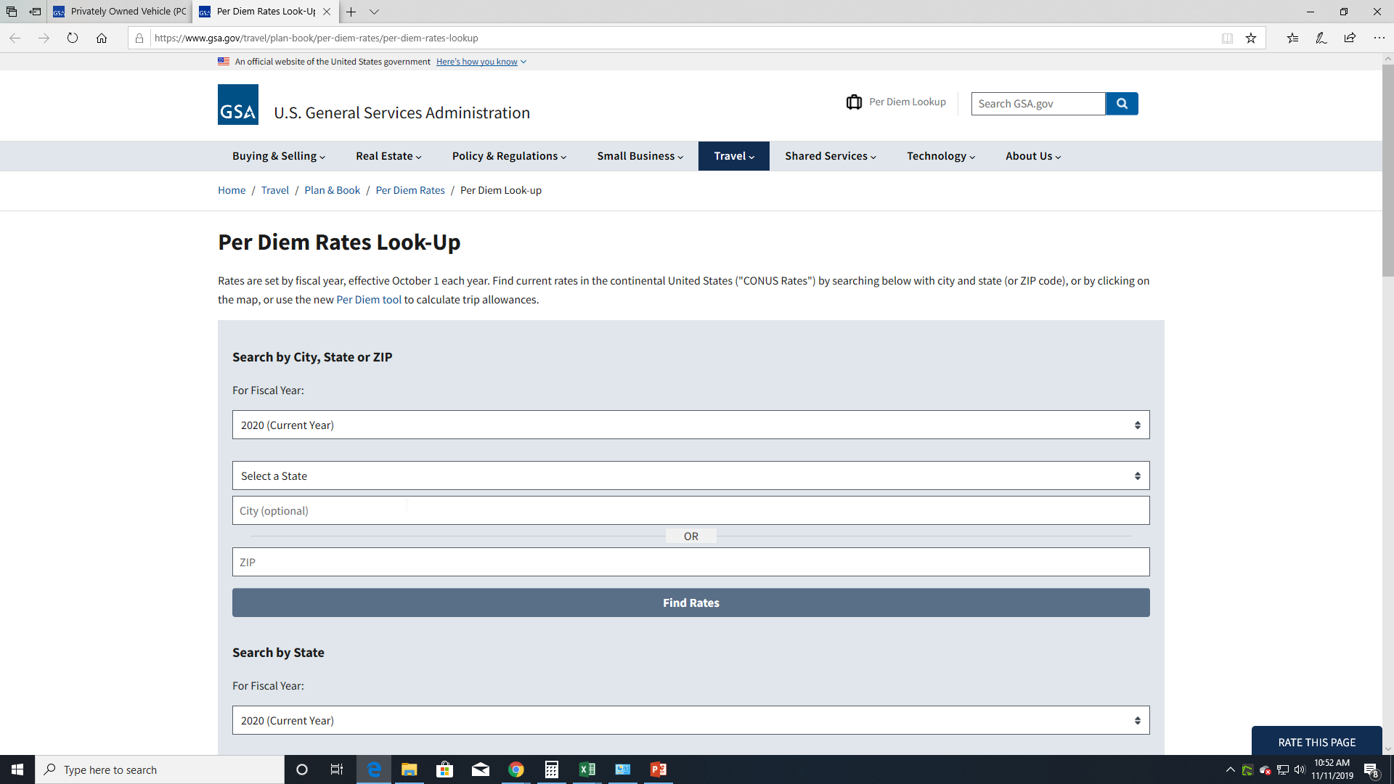
Direct Link from Travel Settlement Form
Click on the blue link for Per Diem on your Travel Settlement for a direct site.

Slide 4
Per Diem Chart
www.GSA.gov

Slide 5
GSA
Go to the www.GSA.gov link and click enter
Scroll down to Per Diem Rates
Click on Per Diem Rate block
Choose the state of destination and the city
Click on Calculate Per Diem Allowances for a Trip
Enter start and end date click next
Enter the rates shown on this page in the Per Diem column on your Travel Settlement Form

Slide 6
Per Diem Rates

Slide 7
Travel Resources

Slide 8
Calculate Per Diem for a Trip

Slide 9
Start & End Travel Dates

Slide 10
Your Search for City & State

Slide 11
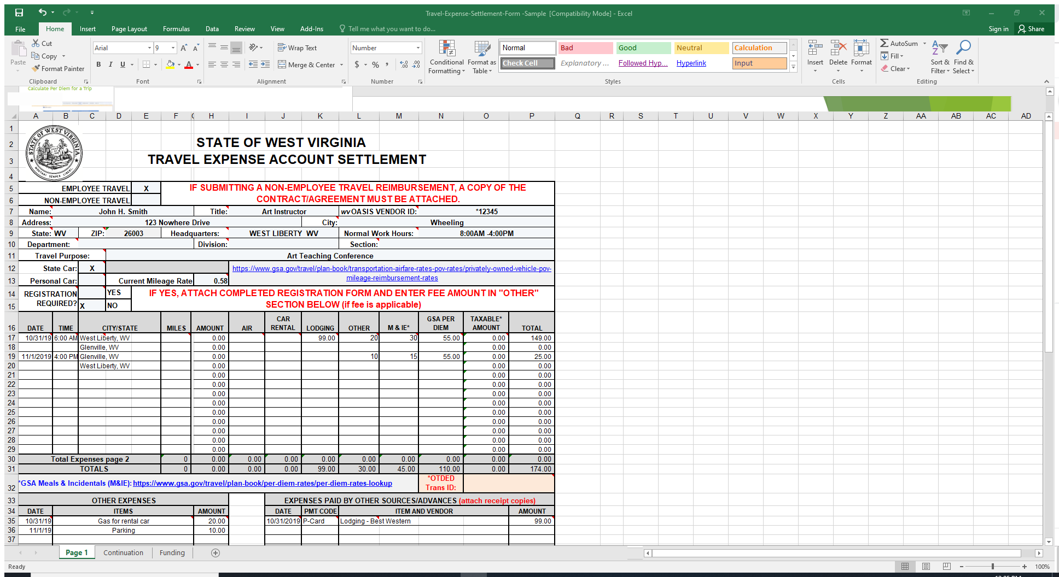
Travel Settlement Form Sample

Slide 12
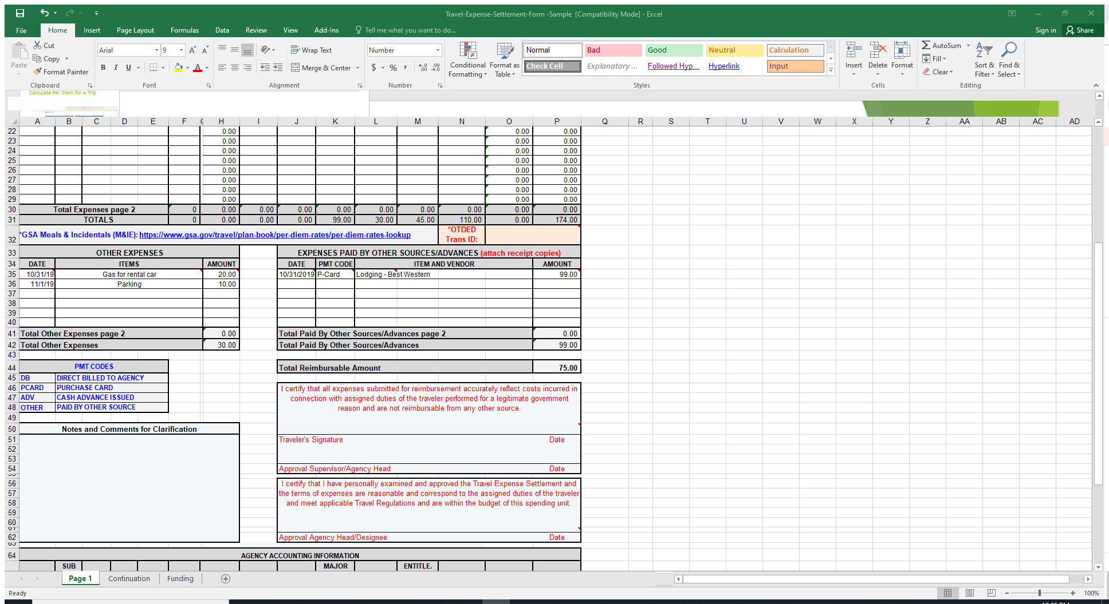
Travel Form Sample

Slide 13
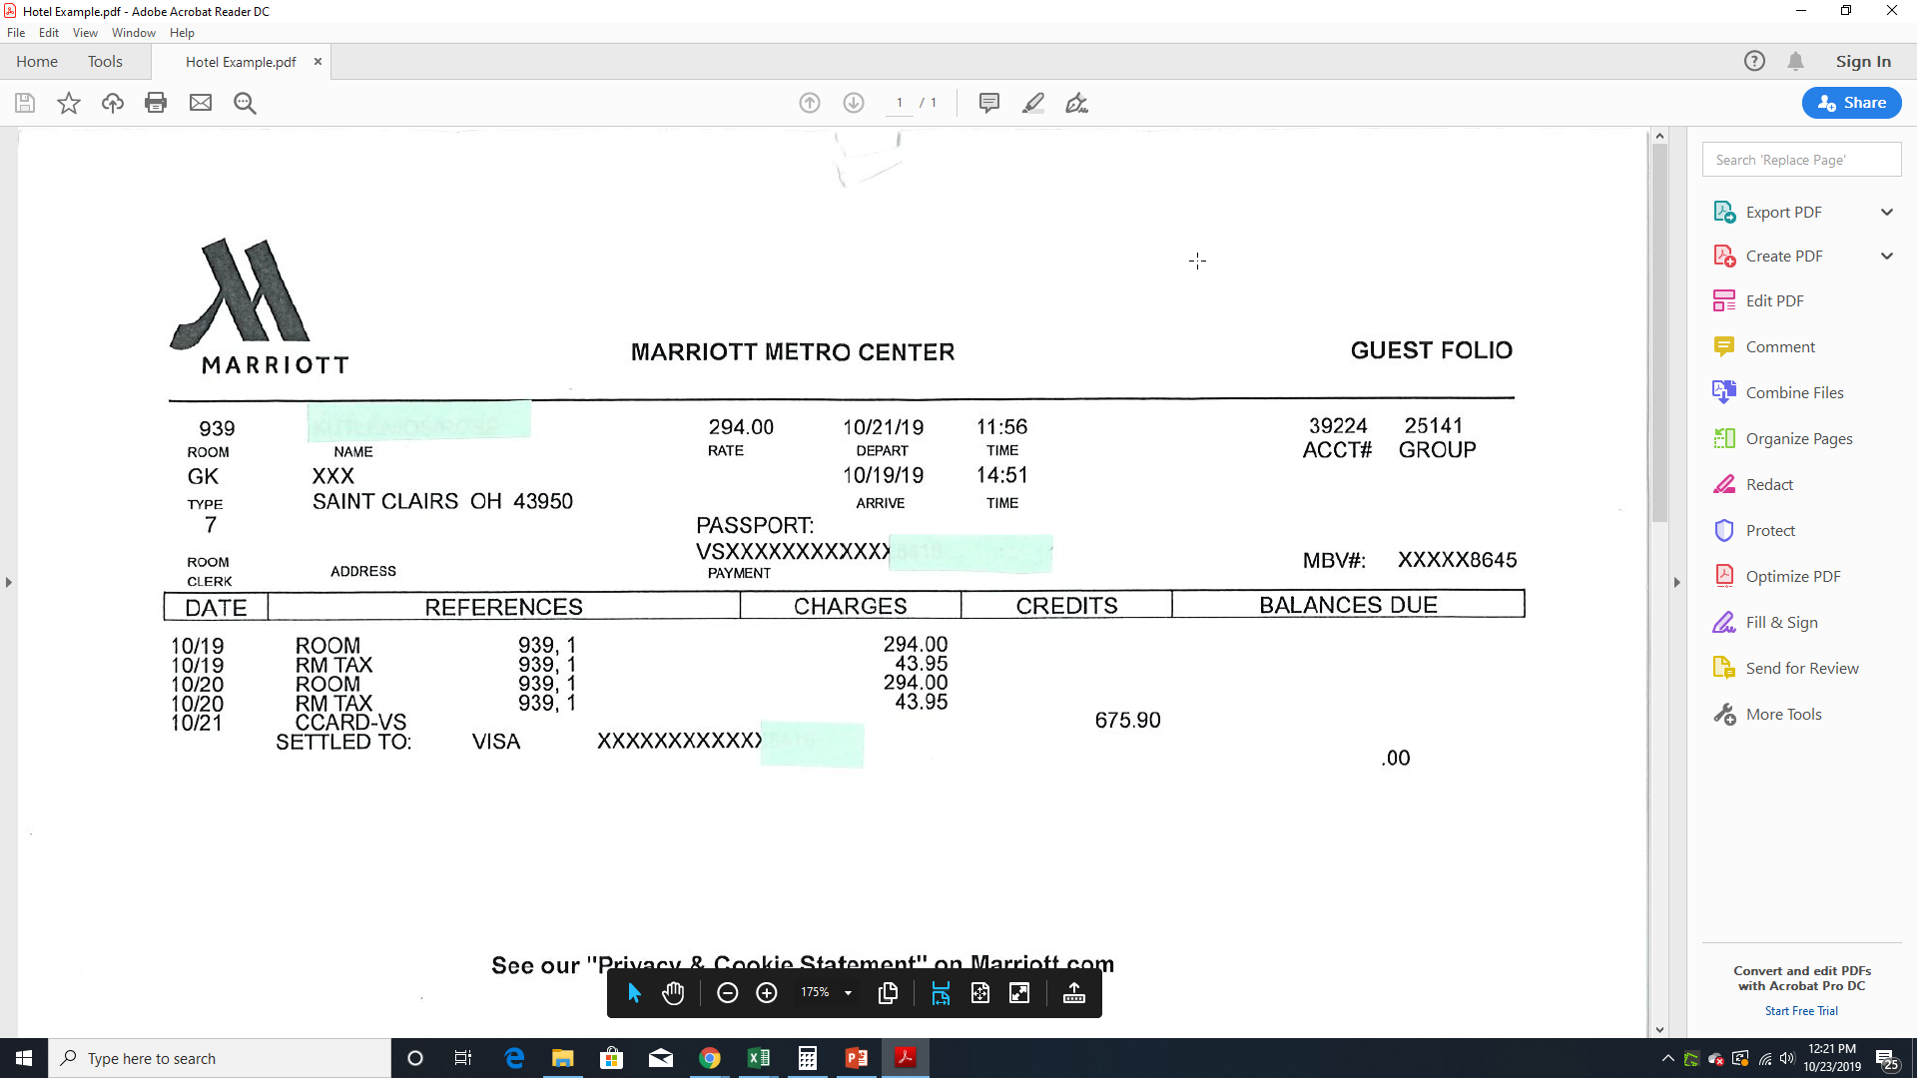
Sample Hotel Receipt
Your hotel receipts should be broken down by day. The state will not accept a receipt showing the charges in one lump sum. Your name exactly as it is in Oasis must be listed on the hotel receipt.

Slide 14
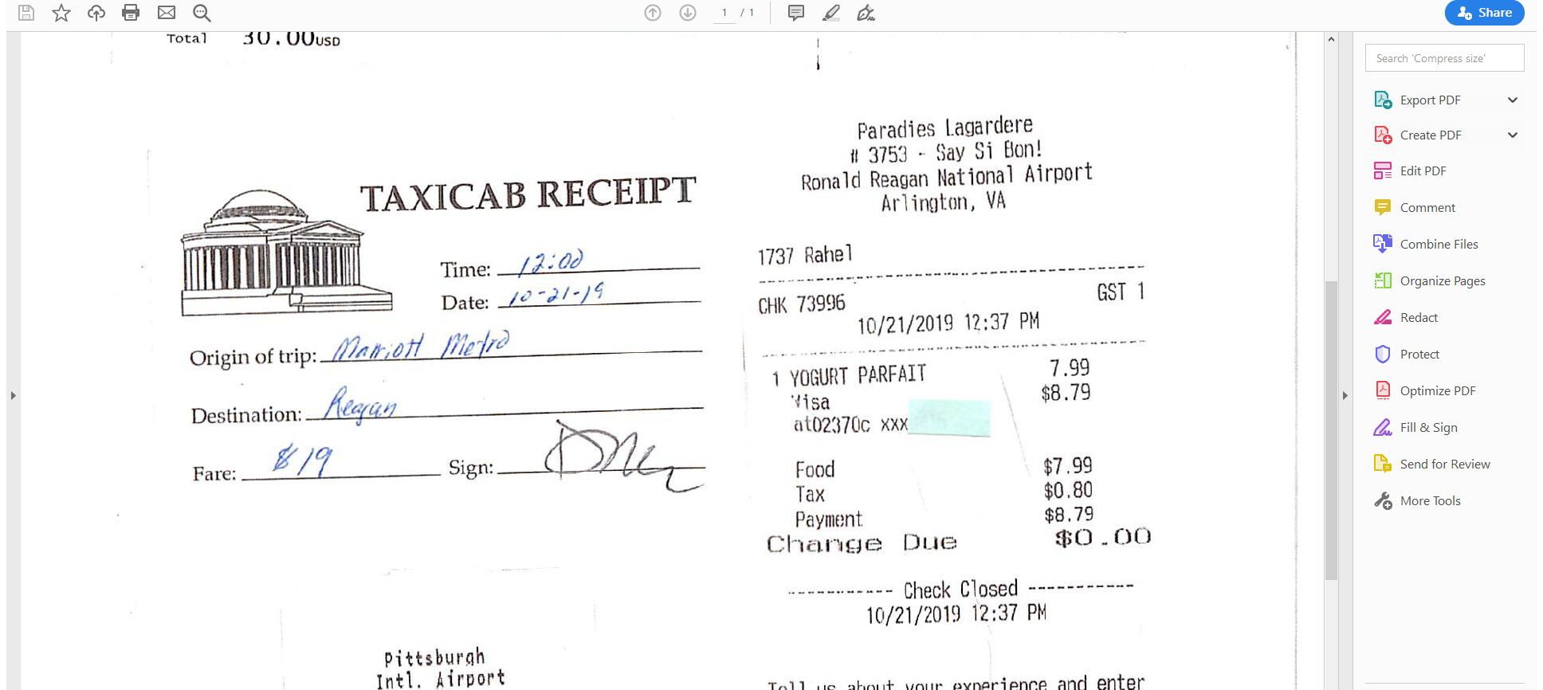
Sample Receipts
Receipts must be original and itemized. It helps if the receipts are neatly taped on paper for expedited processing. If receipts are only paper clipped to the Travel Settlement Form, it takes much longer to organize them, and for scanning purposes, they have to be taped to paper to upload to the state.

Slide 15
Not Acceptable Receipt Submittal

Slide 17
List of Acceptable Purchases
You are allowed to be reimbursed for acceptable items not paid for by P-Card.
Examples:
Hotel expenses paid by personal credit card
Air Fare paid by personal credit card
Car Rentals paid by personal credit card (only for exception reasons)
Meals
Taxis, Uber or Lyft
Parking Fees
Toll Fees (only if no fleet vehicle is available, Fleet vehicles have EZ Pass)

Slide 18
Items Not Reimbursable
Examples:
Alcohol (any type)
Cigarettes (any type)
Personal hygiene products such as:
  Toothpaste
  Toothbrush
  Shaving Crème
  Razors
  Deodorant

Slide 19
Processing
Please submit your Travel Settlement Sheets with all itemized receipts to Shawn Todd at Shaw Hall, Room 315 for logging and processing.
Your Travel Settlement will be reviewed for correctness and required documentation. If there are errors or incomplete information, your Travel Settlement Form will be returned to you for correction and required documents.
Please do not submit documents loosely taped to both sides of the paper, paper clipped or stapled to the form. This slows down the process for everyone.
If everything is correct and all documents are attached, your Travel Settlement Form will be processed within a week for submission to the state for reimbursement.

Slide 20

Q & A Any Questions?

